Slide 1

A thought to ponder . . .
How are you bringing attention and intention to connecting your research to society?
Notes:
Michelle

Slide 2
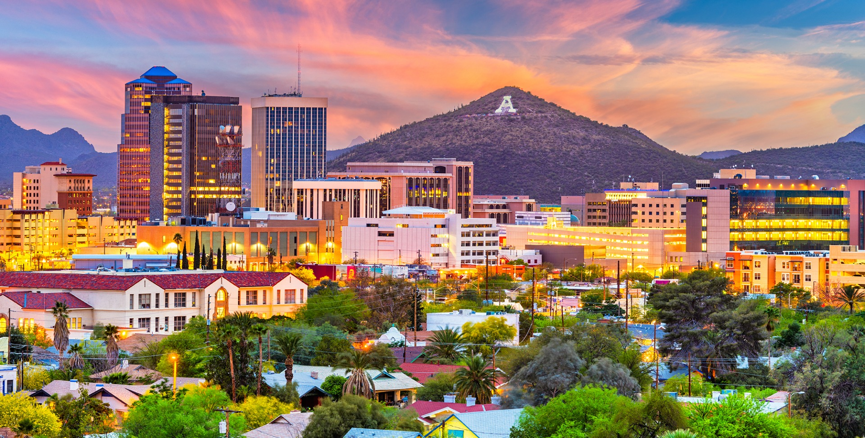
Planning for Research Impact:
Bringing attention & intention to broader & societal impacts
University of Arizona
Jennifer Fields, Executive Director, OSI
Michelle Higgins, Assoc Director, OSI
Alison M. Meadow, Assoc Research Professor, OSI
Gigi Owen, Research Scientist, AIR
University of Missouri
Susan Renoe, Associate Vice Chancellor of Research, Development, and Strategic Partnerships
Notes:
Jen -Welcome Zoom participants,
JF – Introduce self
MH – Introduce self
AM – Introduce self
Gigi– Introduce self
Susan– Give apologies that she cannot be here today
Who else is here – in chat say hello and what your role is? (MAKE SURE THE RIGHT OPTIONS ARE ACTIVE – OR CONSIDER POLL)
- Faculty
- Post Docs
- Administrators
- Researchers
- Practitioners
- Broader Impact or research development professionals
- Students
Who did I miss?

Slide 3
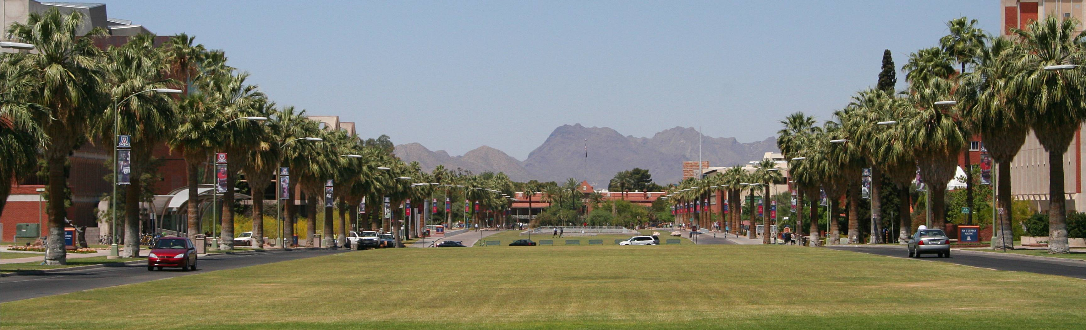
We respectfully acknowledge the University of Arizona is on the land and territories of Indigenous peoples. Today, Arizona is home to 22 federally recognized tribes, with Tucson being home to the O'odham and the Yaqui. Committed to diversity and inclusion, the University strives to build sustainable relationships with sovereign Native Nations and Indigenous communities through education offerings, partnerships, and community service.
This Photo by Unknown author is licensed under CC BY-SA.
Notes:
The University of Arizona was established in 1885, and in 1890 was designated as the state's Land Grant University. We acknowledge ...

Slide 4

Mission: To work collaboratively with University of Arizona’s faculty, researchers, scholars, and practitioners, and in partnership with our communities, to ensure that equitable participation in, and the greatest possible societal impact of, University of Arizona's research is realized.
https://impact.arizona.edu
Notes:
Jen – I think this should be part of your opening slides

Slide 5


Today’s Agenda
What are Societal Impacts of Research?
Why Address Societal Impacts in Our Work?
NSF and Broader Impacts
Resources
Connecting Your Research to Societal Impacts
Best Practices When Planning for Impact
Societal Impacts Frameworks
Societal Impacts Pilot Test

Slide 6






















Research Impact
Societal
Impact
This research is too interesting to go to a peer-reviewed journal to only be seen by others in your discipline
Ask ‘so what?’, then keep asking ‘so what?’ until you can’t ask it again
Disciplinary Impact
Notes:
Jen

Slide 7
Public
Community
Social
Civil
Communal
Collective
Shared
Common
Group
Civic
Societal: Of or pertaining to society (people living together, in a more or less ordered community) or social groups, or to their activities.
Notes:
Jen

Slide 8

Impact:
The effect or influence of one person, thing, or action on another
To have a strong effect on something or someone
Notes:
Jen

Slide 9
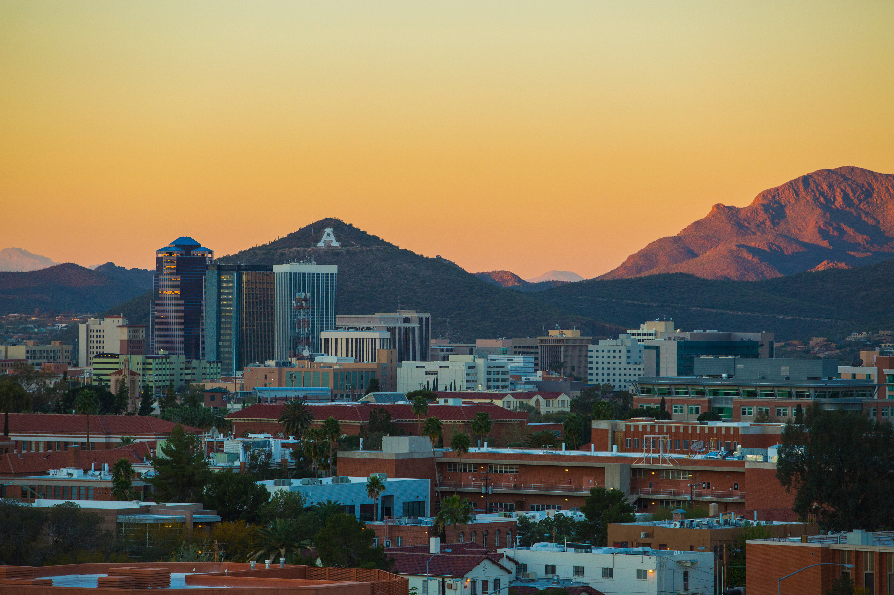
What are Societal Impacts of Research?
Societal impacts are the ways that research, and
the process of conducting research, contributes to society beyond the academic realm
Notes:
Jen
Broader Impacts is the term NSF uses to describe researchers moving their research beyond the lab to impact the public good, thereby benefitting the economy, society and discovery itself. As more agencies and organizations are bringing these concepts and requirements into their funding programs, language is shifting to societal impacts

Slide 10

Why consider the societal impacts of research?
Notes:
Alison

Slide 11
Social Contract
“Society currently expects two outcomes from its investment in science. The first is the production of the best possible science regardless of area; the second is the production of something useful.”
—Jane Lubchenco, 1998
Lubchenco J (1998) Entering the Century of the Environment: A New Social Contract for Science. Science 279:491-497. doi:10.1126/science.279.5350.491
Notes:
What is our responsibility when it comes to the work that we do? What do we owe others – particularly when we have public funding?
Jane Lubchenco (former NOAA Administrator and current White House Deputy Director for Climate and the Environment) called this the social contract. The idea that we have a contract with society to contribute to society with our work.

Slide 12
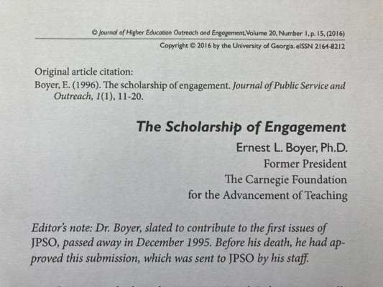
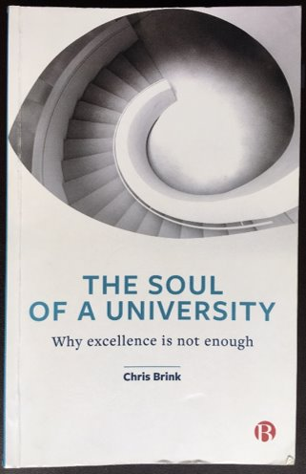
Scholarship of Engagement
“[Our] outstanding universities and colleges remain, in my opinion, one of the greatest hopes for intellectual and civic progress in this country. I’m convinced that for this hope to be fulfilled, the academy must become a more vigorous partner in the search for answers to our most pressing social, civic, economic and moral problems, and must reaffirm its historic commitment to what I call the scholarship of engagement.” ​
Ernest L Boyer, 1996​
Abundant thanks to Chris Brink for his presentation on this topic at AESIS in May 2022.
Notes:
There are also ethical reasons why we need to practice the scholarship of engagement. We simply have a responsibility to use the resources and privilege available to us in higher education/research organizations to try to do better.

Slide 13

Land Grant Mission
Our universities were founded specifically to benefit the public, and the research that public and land-grant universities produce serves this need. Now, more than ever, we need to elevate and communicate the impact that public university research has on everyday life. We also need to emphasize the value of collaborative research with communities—not just about communities.”
https://www.aplu.org/our-work/2-fostering-research-innovation/public-impact-research/
Notes:
APLU calls this Public Impact Research and has called on US public universities to embrace this work.
They note that US public universities were founded on the idea of serving the public good
They note the erosion of trust in public education and view PIR as one component of regaining public trust

Slide 14
. . . And funders are responding
USDA-NIFA
Sustainable Agricultural Systems Program
“help transform the U.S. food and agricultural system to increase agricultural production while also reducing its environmental footprint. Achieving these goals will require transdisciplinary approaches to address current and future agricultural challenges within the context of the economic, societal, and environmental attributes of sustainability. . . These approaches must demonstrate current needs and anticipate future social, cultural, behavioral, economic, health, and environmental impacts. Additionally, the outcomes of the work being proposed should result in societal benefits, including promotion of rural prosperity and enhancement of quality of life for all those involved in food and agricultural value chains from production to utilization and consumption.”

Slide 15
. . . And funders are responding
NASA
Research Opportunities in Space and Earth Sciences (ROSES)
“The Inclusion Plan shall clearly state goals for creating and sustaining a positive and inclusive working environment and describe activities to achieve these goals including:
Identify barriers to creating a positive and inclusive working environment that are specific to the team carrying out the proposed investigation.
Address ways in which the investigation team will work to attenuate or reduce these barriers.
Describe roles, responsibilities, and work effort for all team members who will be participating in Inclusion Plan activities.
Show a timeline for completing or carrying out proposed activities.
Contain assessment mechanisms for evaluating progress towards achieving the proposed Inclusion Plan activities or goals.”

Slide 16
. . . And funders are responding
European Commission - Research and Innovation Horizon Europe Programme
“Projects results are expected to contribute to all of the following expected outcomes:
Regions, local authorities and communities have been involved in development and testing of a whole range of transformative solutions that will help to mitigate the effect of climate change on health and human wellbeing, including making the public health sector more climate resilient and better prepared to mitigate the climate change related health challenges
Climate resilience solutions that protect human health have been developed, tested and are made largely available.”

Slide 17
. . . And funders are responding
Department of Energy
Bipartisan Infrastructure Law and Inflation Reduction Act Opportunities
“Community Benefits Plans are based on a set of four core policy priorities:
investing in America's workforce
engaging communities and labor
advancing diversity, equity, inclusion, and accessibility
implementing Justice 40
These key principles, when incorporated comprehensively into project proposals and applications and executed upon, will help ensure broadly shared prosperity in the clean energy transition.”

Slide 18
. . . And funders are responding
Department of Energy
PIER Plans
“All applications must provide a Promoting Inclusive and Equitable Research (PIER) Plan as an appendix to the research proposal narrative. The PIER plan should describe the activities and strategies of the applicant to promote equity and inclusion as an intrinsic element to advancing scientific excellence in the research project within the context of the proposing institution and any associated research group(s).
Plans may include, but are not limited to: . . . enhanced recruitment of undergraduate students, graduate students, and early-stage investigators (postdoctoral researchers, and others), including individuals from diverse backgrounds and groups historically underrepresented in the research community; strategies for creating and sustaining a positive, inclusive, safe, and professional research and training environment that fosters a sense of belonging among all research personnel; and/or training, mentoring, and professional development opportunities.
Plans may incorporate or build upon existing diversity, equity, accessibility, and inclusion efforts of the project key personnel or applicant institution(s) but should not be a re-statement of standard institutional policies or broad principles. The complexity and detail of a PIER is expected to increase with the size of the research team and the number of personnel to be supported.

Slide 19
. . . And funders are responding
NSF Broader Impacts
“By evaluating every proposal it receives according to its intellectual merit and its broader impacts, NSF ensures that publicly funded research has tangible benefits to society that go beyond increasing knowledge. . . How does your research benefit society?”

Slide 20
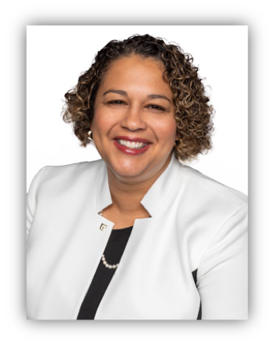



The Evolution of Broader Impacts
Dr. Susan D. Renoe
Executive Director, ARIS
Associate Vice Chancellor for Research, Development & Strategic Partnerships
Assistant Professor of Strategic Communication,
University of Missouri
researchinsociety.org
@ARISImpacts
This Photo by Unknown Author is licensed under CC BY-NC

Slide 21
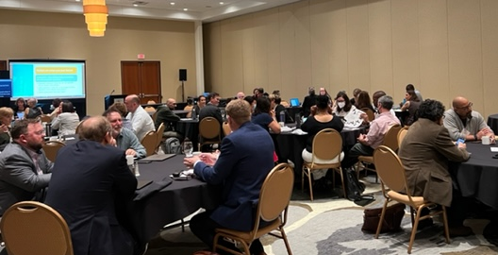
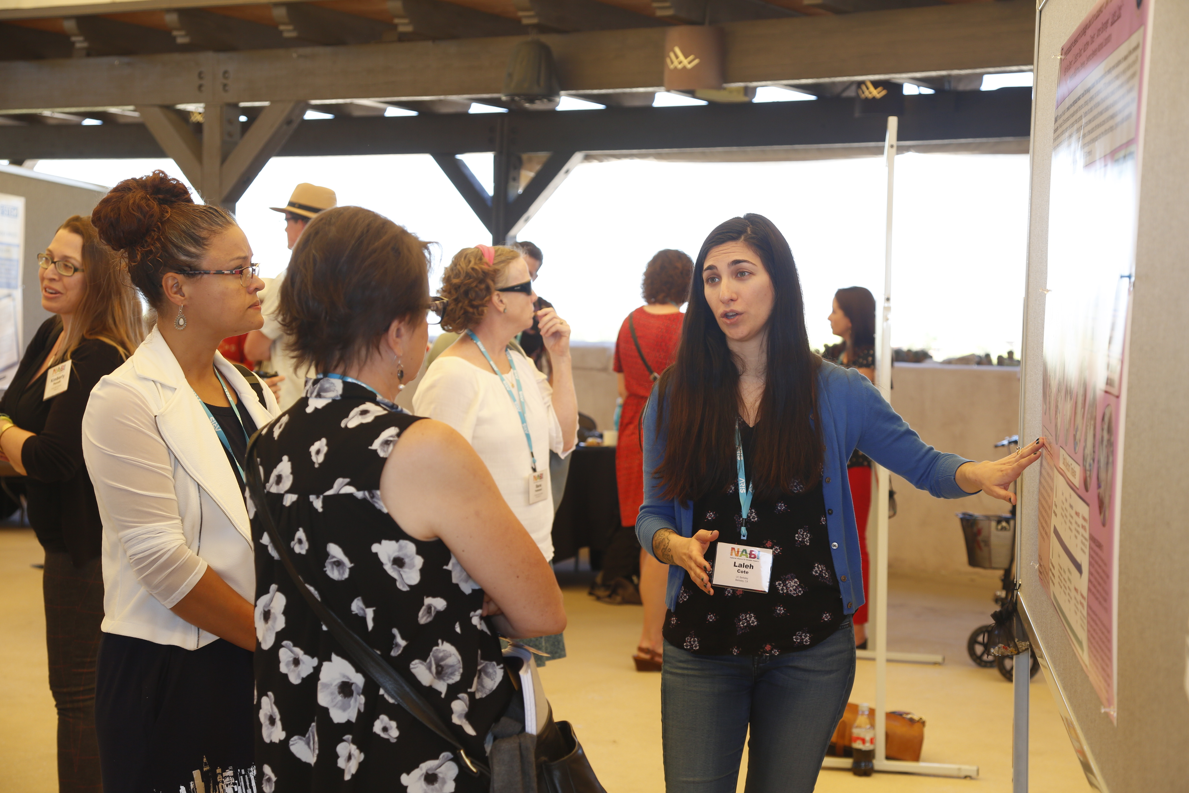
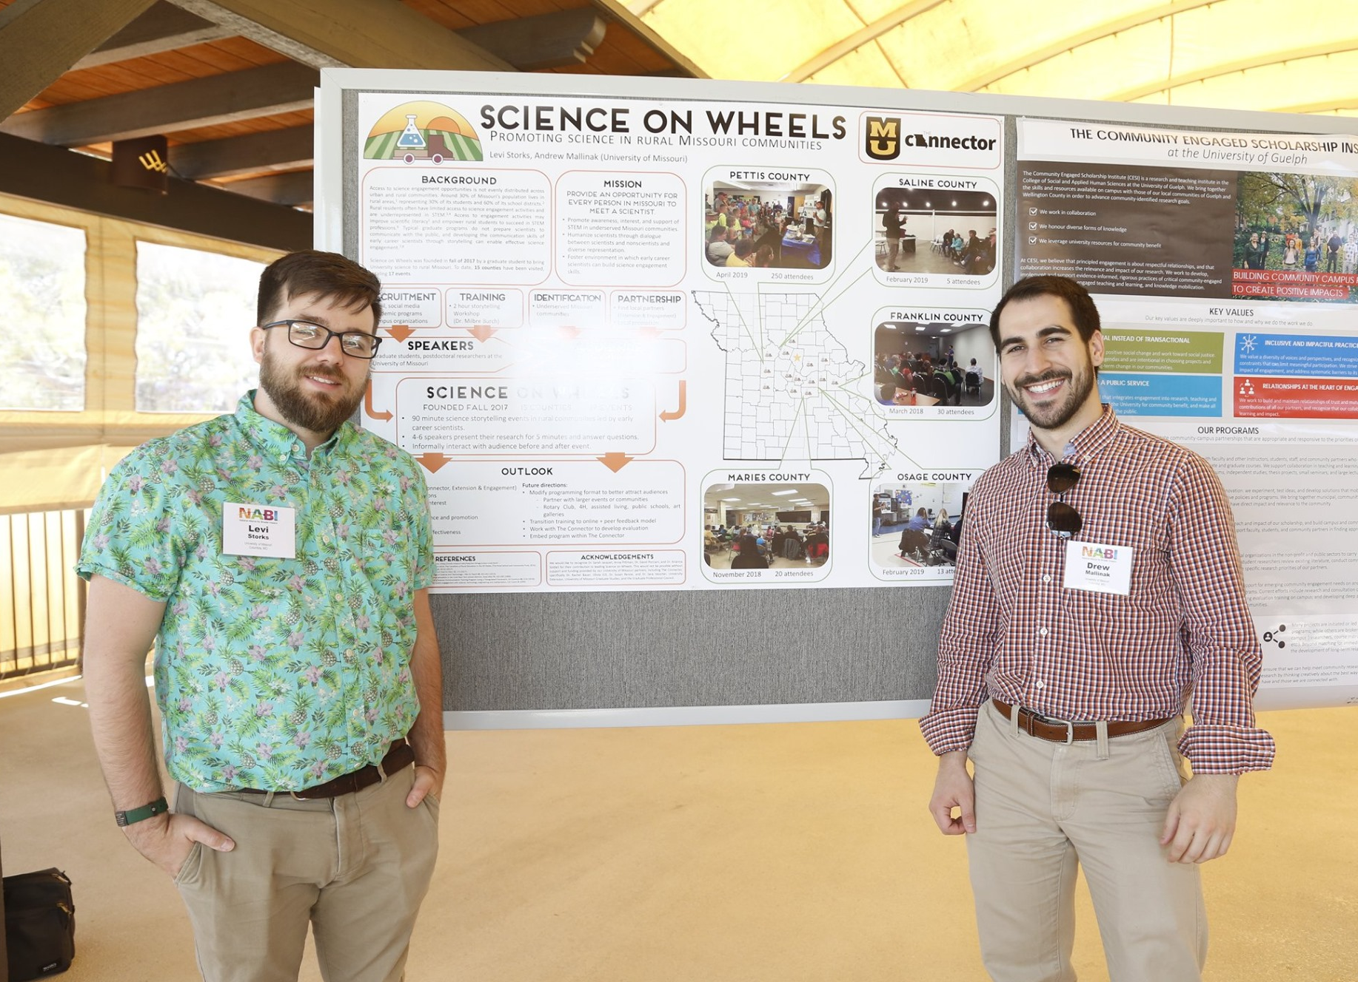

Mission
ARIS’s mission is to amplify the impacts of research for the benefit of society.
To do this, ARIS:
Serves as the hub for expertise in and the promotion of research impacts.
Advances scholarship, builds and stewards a growing field of practice and community of professionals, across academic, educational, governmental, corporate, and non-profit institutions and agencies, focused on the impacts of research.
Supports investigators from diverse fields and the professionals and partners who collaborate with them to achieve societal impact.
Partners with the National Science Foundation and other U.S.-based and international organizations, aligned to ARIS’s vision to prioritize research impacts for societal benefit.
Notes:
Professionalization of BI

Slide 22





NSF’s Broader Impacts Categories
“Archived” List
America COMPETES 2010
AICA 2017
PAPPG
(current)
Advance discovery, training graduate students, mentoring postdoctoral researchers and junior faculty, involving undergraduates | Development of a globally competitive STEM workforce; improved undergraduate STEM education; improved pre-K-12 STEM education and teacher development | Developing an American STEM workforce that is globally competitive through improved pre-K-12 STEM education and teacher development, and improved undergraduate STEM education and instruction | Improved STEM education and educator development at any level; development of a diverse, globally competitive STEM workforce
Broaden participation of under- represented groups | Increased participation of women and underrepresented minorities in STEM | Expanding participation of women and individuals from underrepresented groups in STEM | Full participation of women, persons with disabilities, and underrepresented minorities in STEM
Enhance infrastructure for research and education | Increased partnerships between academia and industry | Enhancing partnerships between academia and industry in the U.S. | Enhanced infrastructure for research and education; increased partnerships between academia, industry, and others
Broaden dissemination to enhance scientific and technological understanding | Increased public scientific literacy | Improving public scientific literacy and engagement with science and technology in the U.S. | Increased public scientific literacy and public engagement with science and technology
Benefits to society may occur when results of research and education projects are applied | Increased national security and economic competitiveness of the U.S. | Increasing the economic competitiveness of the U.S.; advancing the health and welfare of the American public; supporting national defense | Improved well-being of individuals in society; improved national security; increased economic competitiveness of the U.S.
Training Students, STEM Education, and Workforce
Broadening Participation
Enhanced Infrastructure and Partnerships
Knowledge Dissemination and Scientific Literacy
Societal Impact and
Economic Competitiveness
Notes:
Jen
1951 - March: Alan T. Waterman, chief scientist at the Office of Naval Research, is nominated by President Truman to become the first director of the NSF. (Waterman Biography) He is provided with an initial appropriation of $225,000.
1952 - February 1: The National Science Board approves the first 28 research grants to be awarded by NSF. The first grant, for $10,300, goes to the Institute for Cancer Research. A total of 97 research grants are awarded in the first year. Among the recipients is Max Delbruck (Nobel Prize, 1969).
Since the NSF first began awarding research funding in 1952, worthy proposals have always outnumbered available funds.
Up until the 1980’s reviewers used two main criteria for evaluating proposals: the intrinsic scientific merit of the proposal, and the qualifications and competence of the principal investigator. “nontechnical” components known as Broader Impacts, were used to select “from among the good proposals when the NSF’s budget allowed it to fund only a fraction of...proposals” (Rothenberg, 2010: 294).
To make the distinction between “basic” and “applied” research less rigid, NSB in 1981, adopted a merit-review standard for NSF proposals, which consisted of four criteria: 1) research performance competence of the principal investigator and supporting institution, 2) intrinsic merit of the proposed research, 3) utility or relevance of the research, and 4) effect of the proposed research on the infrastructure of science and engineering.
In 1996, surveys showed that most reviewers lacked an understanding of Broader Impacts (Rothenberg,2010: 297). At that time, it was recommended that the criteria be simplified and clarified, and the review criteria were reduced from four to two: intellectual merit and broader impacts.
In 1997, based on recommendations from the Committee on Equal Opportunities in Science and Engineering (CEOSE) which provides advice to the NSF on policies and programs that encourage full participation by women, minorities, and persons with disabilities in STEM, NSB simplified the merit review criteria for proposals from four to two – intellectual merit and broader impacts (NSB/MR-97-05, NSF News Release 97-028). NSF defined broader impacts using five general subcategories: 1) integrating research and education, 2) broadening the participation of underrepresented groups, 3) enhancing the infrastructure for research and/or education, 4) disseminating project results broadly to enhance understanding of science and technology, and 5) describing potential benefits to society at large.
In 2010, the U.S. Congress passed the America Competes Reauthorization Act (ACRA), which provided funding for the NSF. The Broader Impacts review criterion was specifically addressed in the ACRA. It stipulated that the NSF apply the BI review criterion to achieve societal goals
In 2017, the American Innovation and Competitiveness Act (AICA) was signed which again slightly revised and condensed the BI criterion.
These goals have been updated annually in the NSF Proposal & Award Policies & Procedures Guide.
In January 2018, NABI compiled data from their own annual summits, findings from NSF’s Office of Integrative Activities two-year study of broader impacts implementation, and NSF’s annual Committee of Visitors report on how the broader impacts criterion is being applied across programs and directorates. Their findings, published in the report, “Current State of Broader Impacts: Advancing Science and Benefiting Society” lists seven common issues across all stakeholder groups:
Broader impacts criterion is unclear.
Random judgments on broader impacts are common in the merit review process.
Relative weighting of intellectual merit and broader impacts is not consistent; broader impacts is used by reviewers as a tie-breaker rather than a more substantial and equally weighted criterion.
It is unclear whether broader impacts need to be specifically related to the research aspects of the proposal.
Academic culture does not reward broader impacts activities and dissemination.
Resources to support broader impacts are lacking at the individual, institutional, and national levels.
Universities, governmental representatives, and non-academic partners need better ways to understand and communicate about broader impacts internally and externally to demonstrate research value.
These examples of societally relevant outcomes should not be considered either comprehensive or prescriptive. Proposers may include appropriate outcomes not covered by these examples, and it should be noted that it is not expected to address all or most of these outcomes in a single proposal.

Slide 23
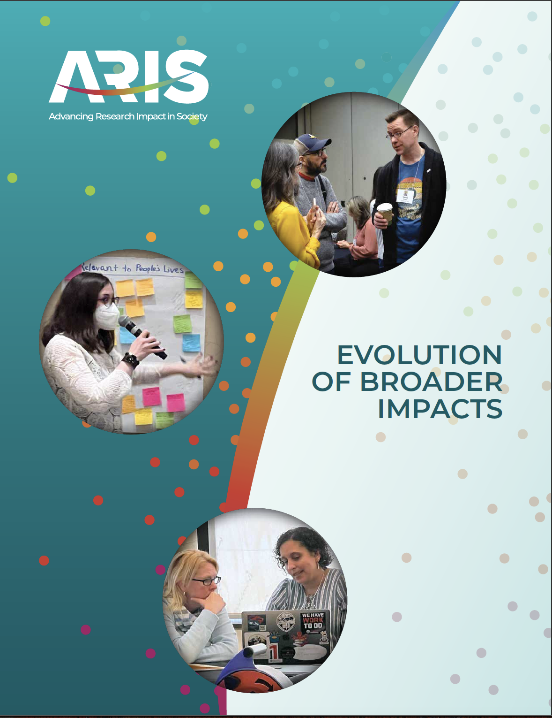
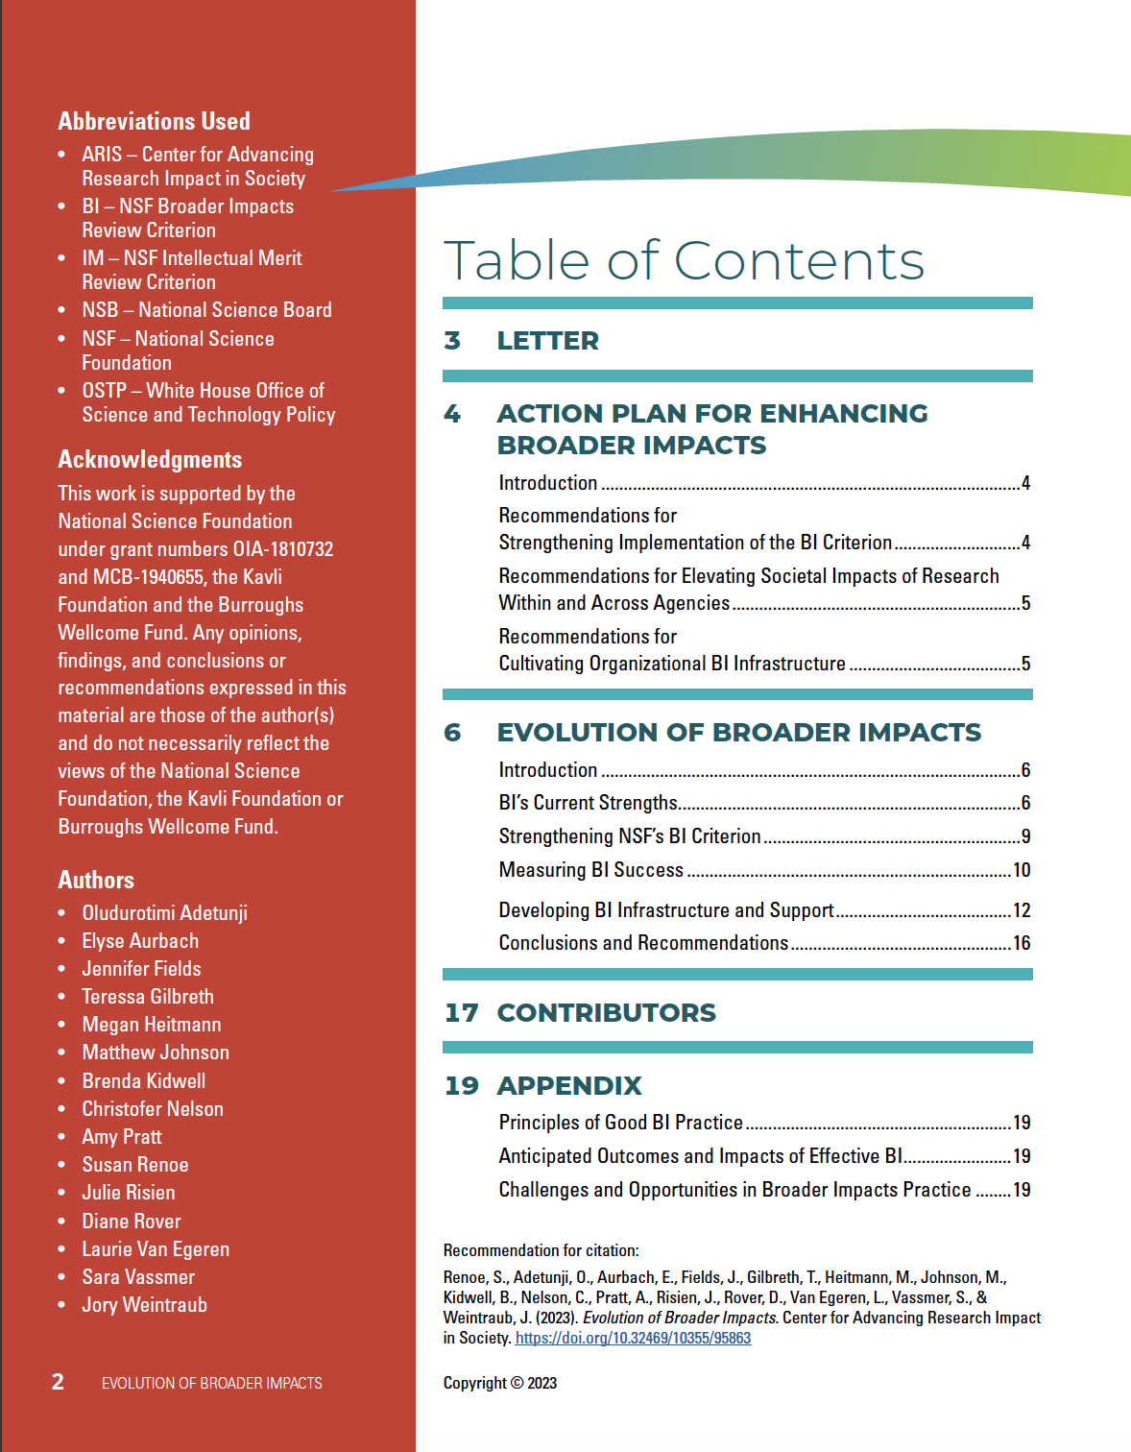
Intellectual merit is clearly understood by the research community, but BI continues to be challenging in definition and implementation.
The Center for Advancing Research Impact in Society (ARIS) convened more than 100 members of the impact community from March to November 2022 to discuss the current state and desired evolution of NSF’s BI criterion.
Evolution of Broader Impacts
2023 report
https://researchinsociety.org/resource/evolution-of-broader-impacts/

Slide 24
Key Findings
BI's Current Strengths
Highlighting and prioritizing the BI criterion: BI is both a practical and symbolic indicator of the importance of using federal funds to make societal change beyond academic circles.
Proposal and review process strengths: The NSF’s emphasis on Bl has provided a critical anchor in developing the Bl field and inspiring institutions to build capacity to increase the societal impact of research.
Emphasizing societal impact through NSF investments: The establishment of ARIS provides important infrastructure to the BI field. NSF’s ongoing support of ARIS and investment in the ARIS toolkit demonstrates its commitment to supporting and enhancing the BI criterion.
National policy’s influence on BI infrastructure: NSF’s BI requirement helps align researcher's impact work with university and national priorities and garner stronger support from university administration. This results in better research outcomes, as it facilitates a clear BI vision from the outset and encourages the engagement of communities and stakeholders.

Slide 25
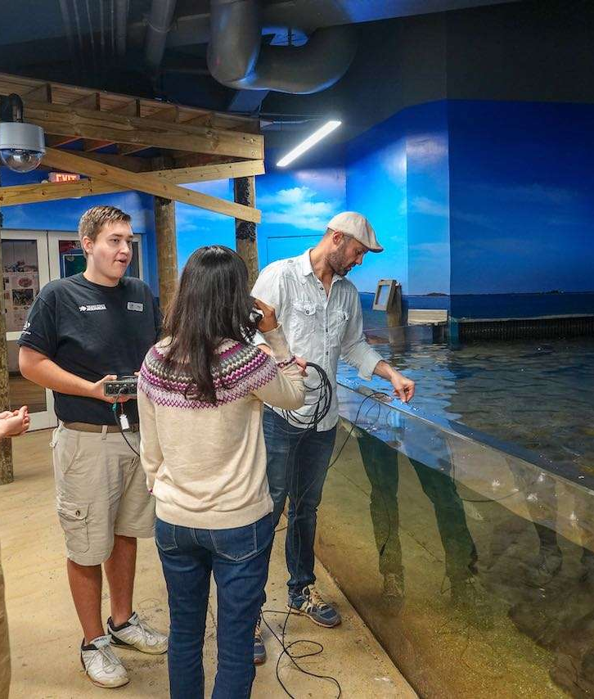
BI’s Current Strengths
Emphasizing societal impact through NSF programming
ARIS
The Directorate for Technology, Innovation and Partnerships (TIP)
Broadening participation and enhancing community engagement through innovative programming:
  NSF INCLUDES
  GRANTED
  EPIIC
  CISE BPC Initiative
  HBCU UP/EIR
  TCUP
  Advanced Technological Education
  Regional Innovation Engines
  Convergence Accelerator

Slide 26


BI’s Current Strengths
More inclusive engagement in science benefits the American people, the environment, and the economy. Agencies should invest in making Federally funded R&D accessible to the public. Agencies should seek out public participation in R&D programs wherever possible.
National Policy’s Influence on BI Infrastructure
A strong majority of the ARIS community believes that
The NSF’s BI requirement positively or very positively impacted their capacity to advance their BI work.
Their institution views NSF’s BI requirement as a rationale to do BI work.
NSF’s BI requirement helps to align their BI office’s work with the larger university and nationally and catalyzes buy-in from administration.
−OSTP FY23 Federal Priorities Memo

Slide 27


Opportunities to Strengthen BI
What institutions can do:
Develop and implement action plans to create sustainable BI infrastructure that includes current institutional assets.
Create centralized mechanisms to disseminate the results of BI activities and, where appropriate, aggregate evaluation data across BI activities.
Form collaborative partnerships across organizations with shared affinities (e.g., geographical proximity, mission alignment, strategic partnerships, etc.) for capacity building and resource sharing.
What individuals can do:
Work with BI professionals to build sustainable, equitable and assessable BI plans.
Work with administration to demonstrate the need for BI support infrastructure – be a BI champion.
Provide substantive feedback on BI when serving on review panels.

Slide 28
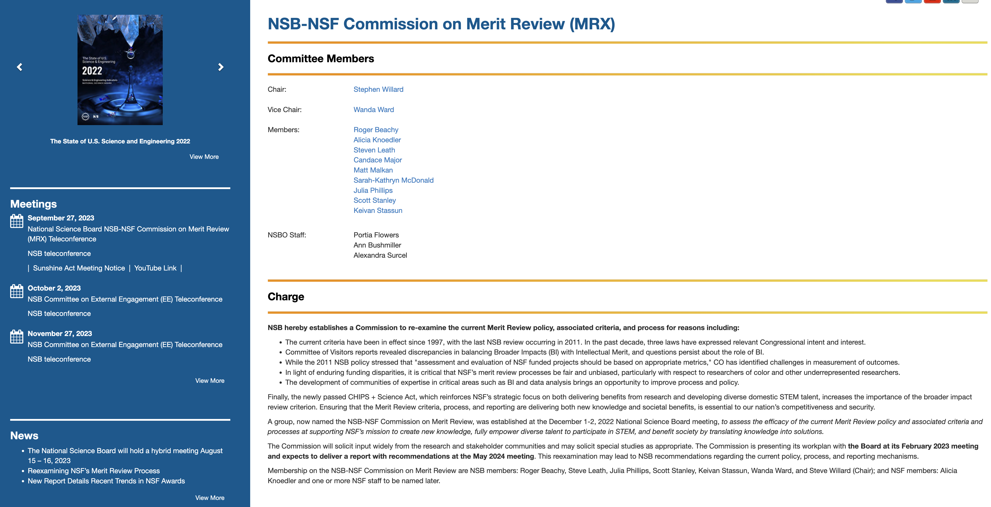
https://www.nsf.gov/nsb/committees/mrxcmte.jsp

Slide 29
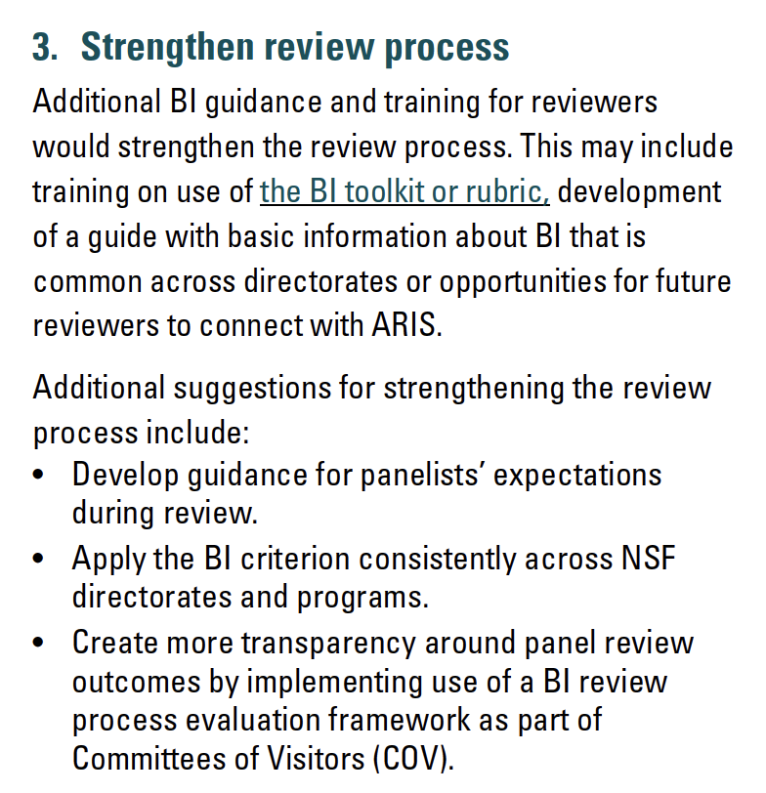
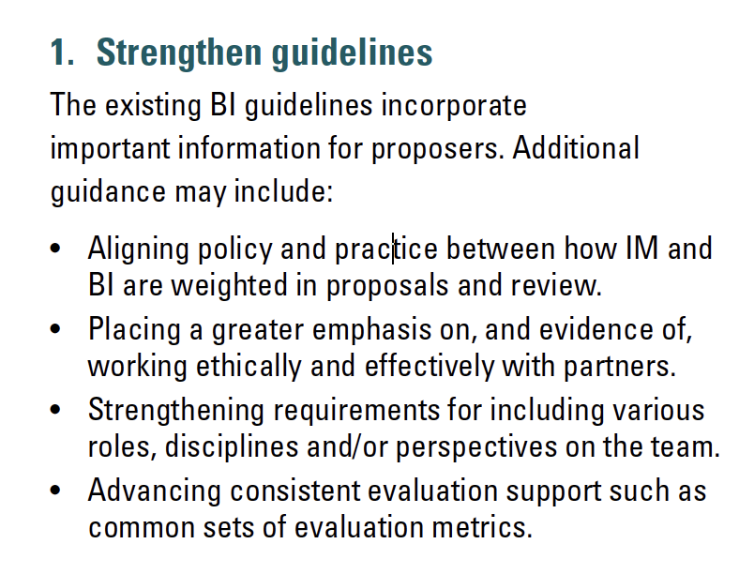
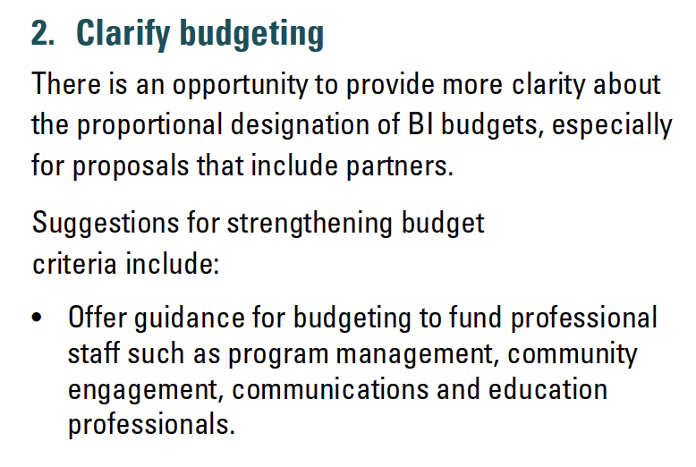
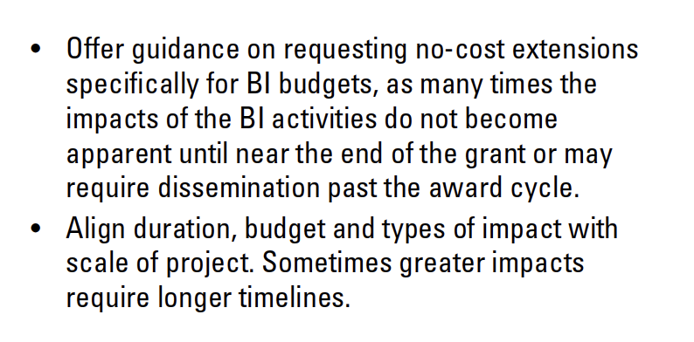
Key Findings
Strengthening NSF's BI Criterion

Slide 30
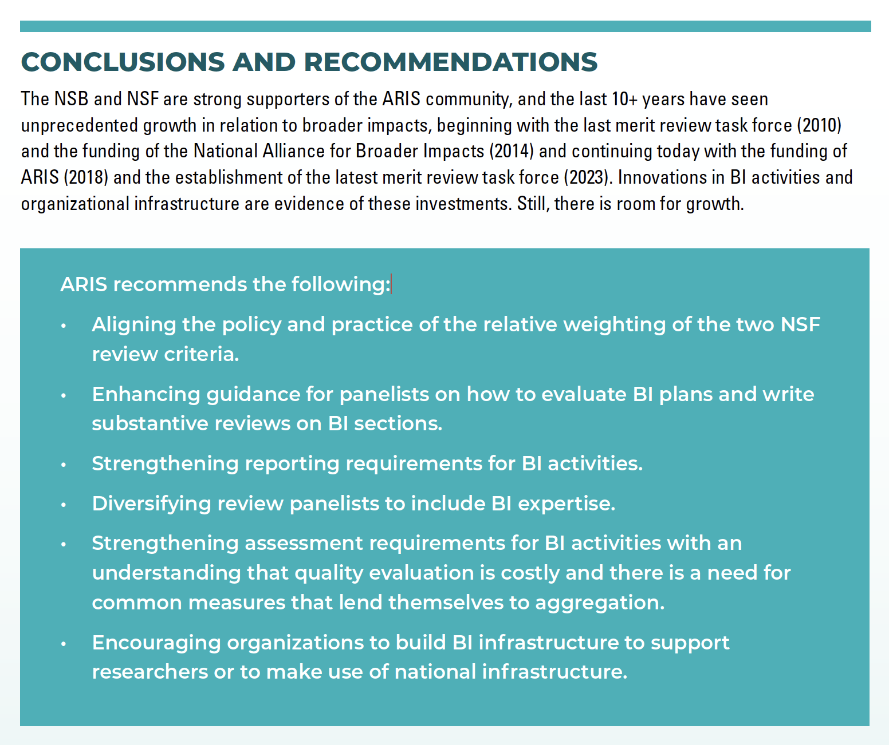

Slide 31
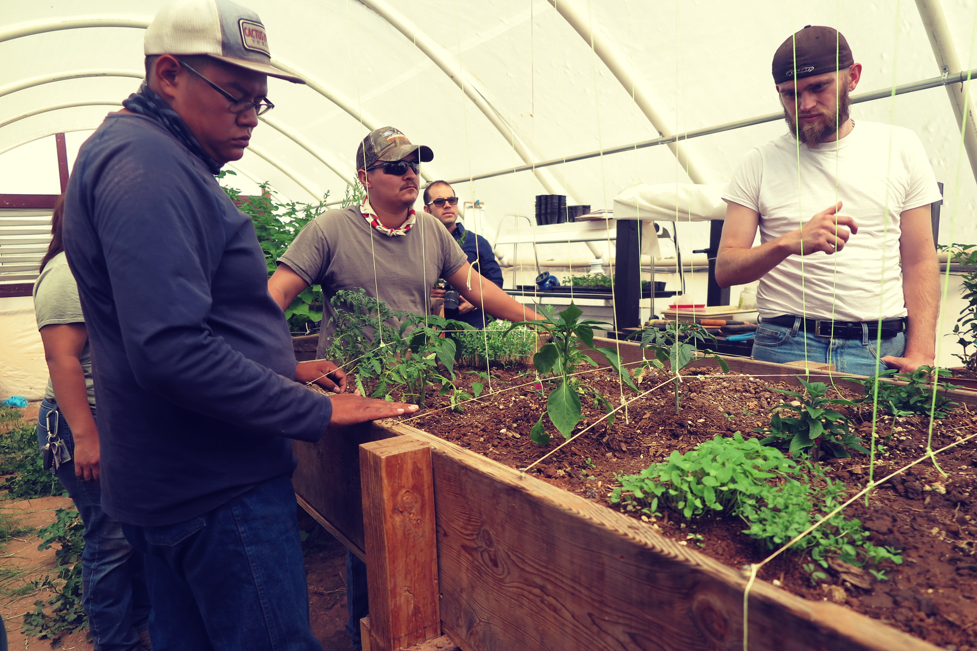
Impact Categories & Frameworks
Notes:
As we've seen, there is growing interest in and support for doing research that engages directly with society and contributes to positive impacts for society. Jen has given us the background on how and why NSF developed its tradition of broader impacts work. We also want to share some additional frameworks for planning and evaluating the societal impact of research. Different frameworks and different categories of impact may be effective for different projects or contexts.

Slide 32
NSF’s Broader Impacts Categories
Inclusion
STEM Education
Public Engagement
Societal Well-Being
STEM Workforce
Partnerships
National Security
Economic Competitiveness
Infrastructure
Notes:
NSF stresses that these are not the only possible impact categories – but this is their current list of examples. You can craft an NSF proposal that addresses one or more of these broader impacts as part of your research.

Slide 33
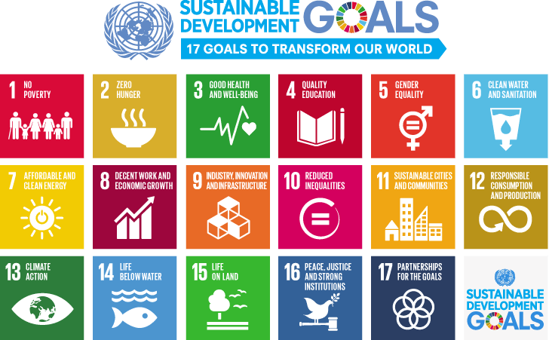
Notes:
An increasingly popular framework of impact goals is the SDGs. The UN Sustainable Development Goals were created in 2015 by the UN General Assembly as a way to work toward the “end [of] poverty, protect the planet, and ensure prosperity for all" by 2030.
These 17 categories can give us a very big goal to aim for. No one research project will solve any of these international goals – but identifying one (or more) SDG as something your research contributes to can put your research in a larger context and community of work. Some universities are tying their impacts directly to contributions to the SDGs – or are selecting one or two SDGs so they become of center of excellence.
The advantage of a shared, international framework is that is allows you to "speak the same language" with researchers around the world – can make it easier to explain what you're working on. However, not everyone's research is a perfect fit . . .
These – and many of the frameworks that follow – are just frameworks. They are ways to describe an area of impact. They don't describe how you have contributed to that impact. They don't in and off themselves offer ways to demonstrate impact. That's up to you to. Wise words from David Phipps of Research Impact Canada, “You can’t move the needle on an SDG by just publishing a paper.”

Slide 34

Areas of Impact:
Impacts on the health and wellbeing of people, and animal welfare
Impacts on creativity, culture and society
Impact on social welfare
Impacts on commerce and the economy
Impacts on public policy, law and services
Impacts on production
Impacts on practitioners and delivery of professional services, enhanced performance or ethical practice
Impacts on the environment
Impacts on understanding, learning and participation
Notes:
Alison
The Research Excellent Framework is a required part of academic life in the United Kingdom.
Assessment occurs every 7 years (this format started in 2014)
Threefold purpose of the REF:
To provide accountability for public investment in research and produce evidence of the benefits of this investment.
To provide benchmarking information and establish reputational yardsticks, for use within the HE sector and for public information.
To inform the selective allocation of funding for research.
How is the REF carried out?
The REF is a process of expert review, carried out by expert panels for each of the 34 subject-based units of assessment (UOAs), under the guidance of four main panels. Expert panels are made up of senior academics, international members, and research users.
For each submission, three distinct elements are assessed: the quality of outputs (e.g. publications, performances, and exhibitions) (60%) , their impact beyond academia (25%) , and the environment that supports research (15%).

Slide 35

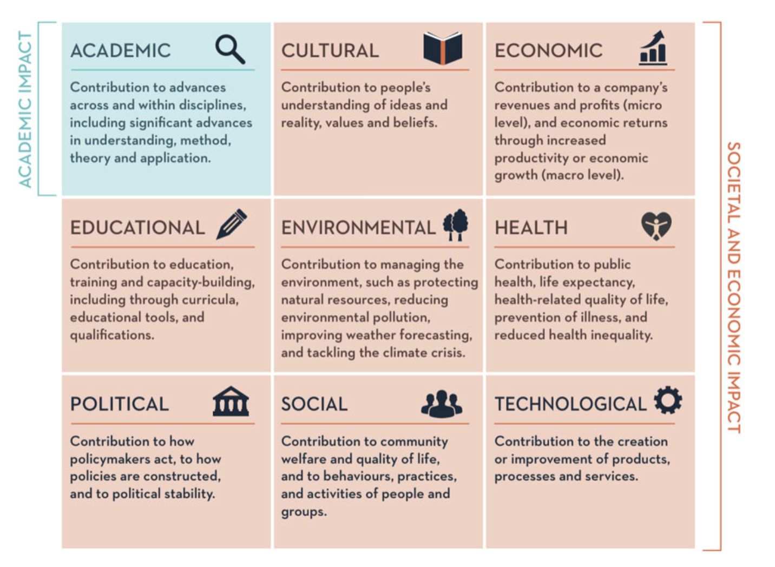
Research Impact Toolkit
Notes:
Alison
Another way of framing the kinds of impacts a university is generating
Remember – this is about categorizing the work, not demonstrating your impact

Slide 36

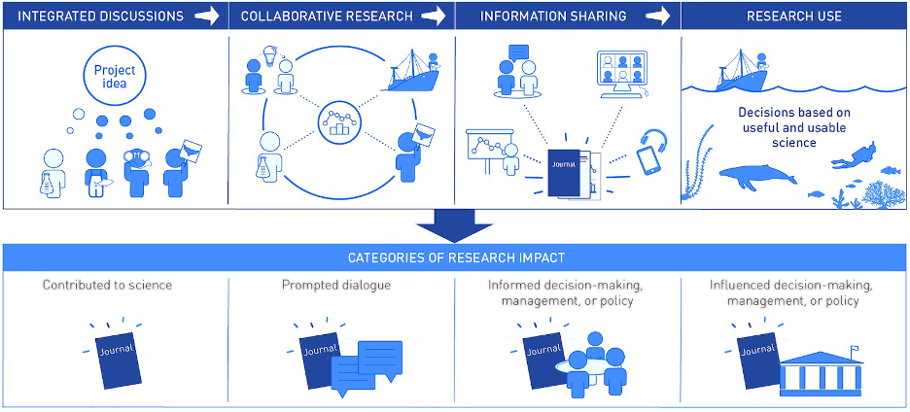
Advanced scientific knowledge and was shared with colleagues in the field by being reviewed by independent external experts, published in scientific journals or other technical reports, and presented at conferences, meetings or other venues as appropriate.
Generated discussion among scientists, managers, and stakeholders, including raising awareness and/or promoting understanding of an issue, or garnering media attention.
Considered directly in discussions by government agencies, resource managers, or other formal decision-making bodies who are deliberating management or policy decisions.
Directly contributed to a new management measure or policy, and/or resulted in changes in management decisions, other ocean-related policies, or on-the-water practices.
Notes:
The Lenfest Ocean Program and the next framework focus on HOW the work has generated impacts.

Slide 37


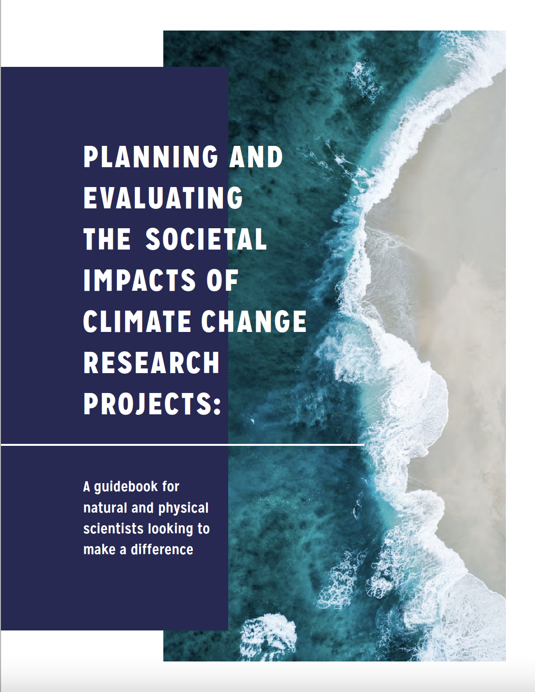



Instrumental impacts – your research led to tangible changes to plans, decisions, practices, or policies
Conceptual impacts – your research contributed to changes in people’s knowledge about or awareness of an issue
Capacity building impacts – your research contributed to enhancing the skills, expertise, or resources of an organization or group of people
Connectivity impacts – your research led to new or strengthened relationships, partnerships, or networks that endure after the project ends
Socio-environmental impacts – changes to social and/or ecological systems, such as improvements in health and well-being or in ecosystem structure and function, that result from actions taken because of your research.
Notes:
We need the categories of impact we’ve described above. But to be truly effective, we need to understand HOW we have impact.
Now we're getting to demonstrating impact . . .
These categories describe the CHANGES the research has contributed to. The first four categories on this list are relatively near-term impacts, meaning you are more likely to be able to observe and document them during the course of a regular research project (2 – 5 years). The final category speaks to the changes we might see in our broader system – that probably have come about because of one or more of the first four. So using this framework can help you understand what changes your research contributed to and *how* they supported larger, longer-term system changes.
This framework can be combined with some of the others we've show – such as by showing how your research had a particular type of impact (instrumental, connectivity) within an SDG category.

Slide 38

Putting the Frameworks into Practice
Example from University of Arizona

Slide 39
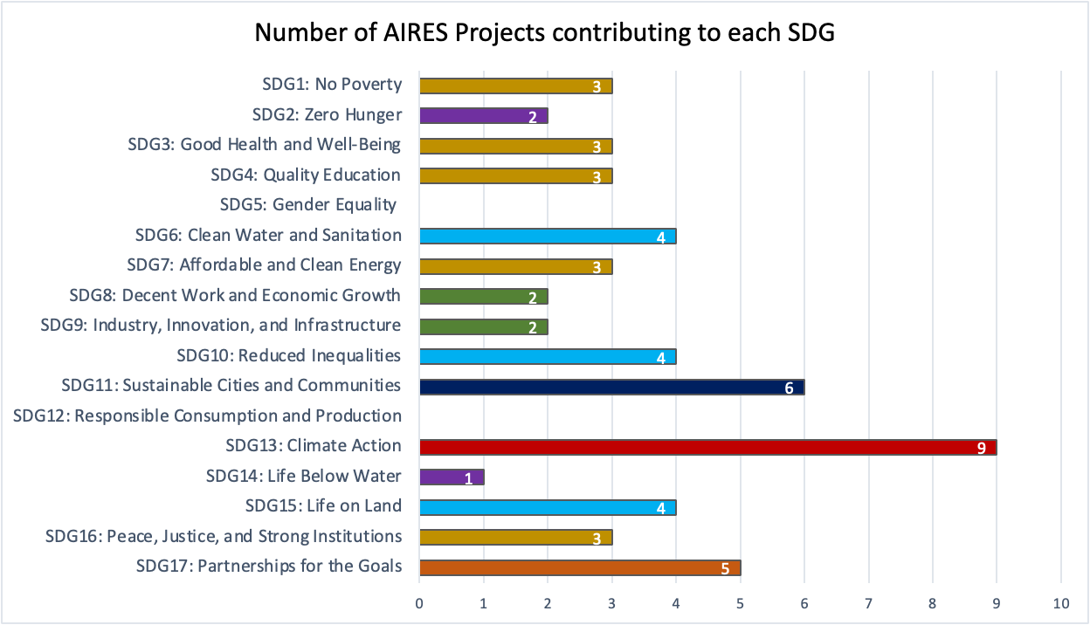
UN SDGs as Impact Goals
What the research contributed to
Arizona Institutes for Resilience – pilot study of 12 projects

Slide 40
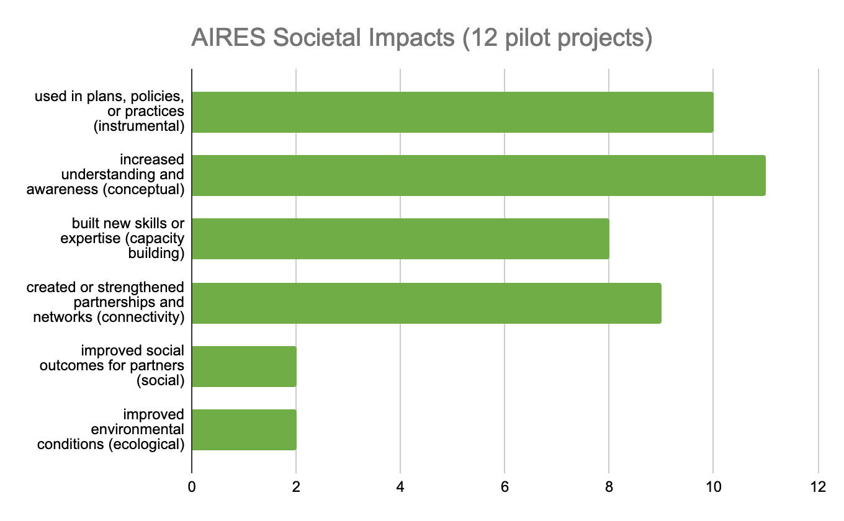
Impact Descriptors
How the research contributed to change
Arizona Institutes for Resilience – pilot study of 12 projects
Notes:
Bringing it back to program scale
This is an example of a aggregation of impact categories across multiple projects within one institute.
Two step process . . . Descriptive categories of impact . . .

Slide 41
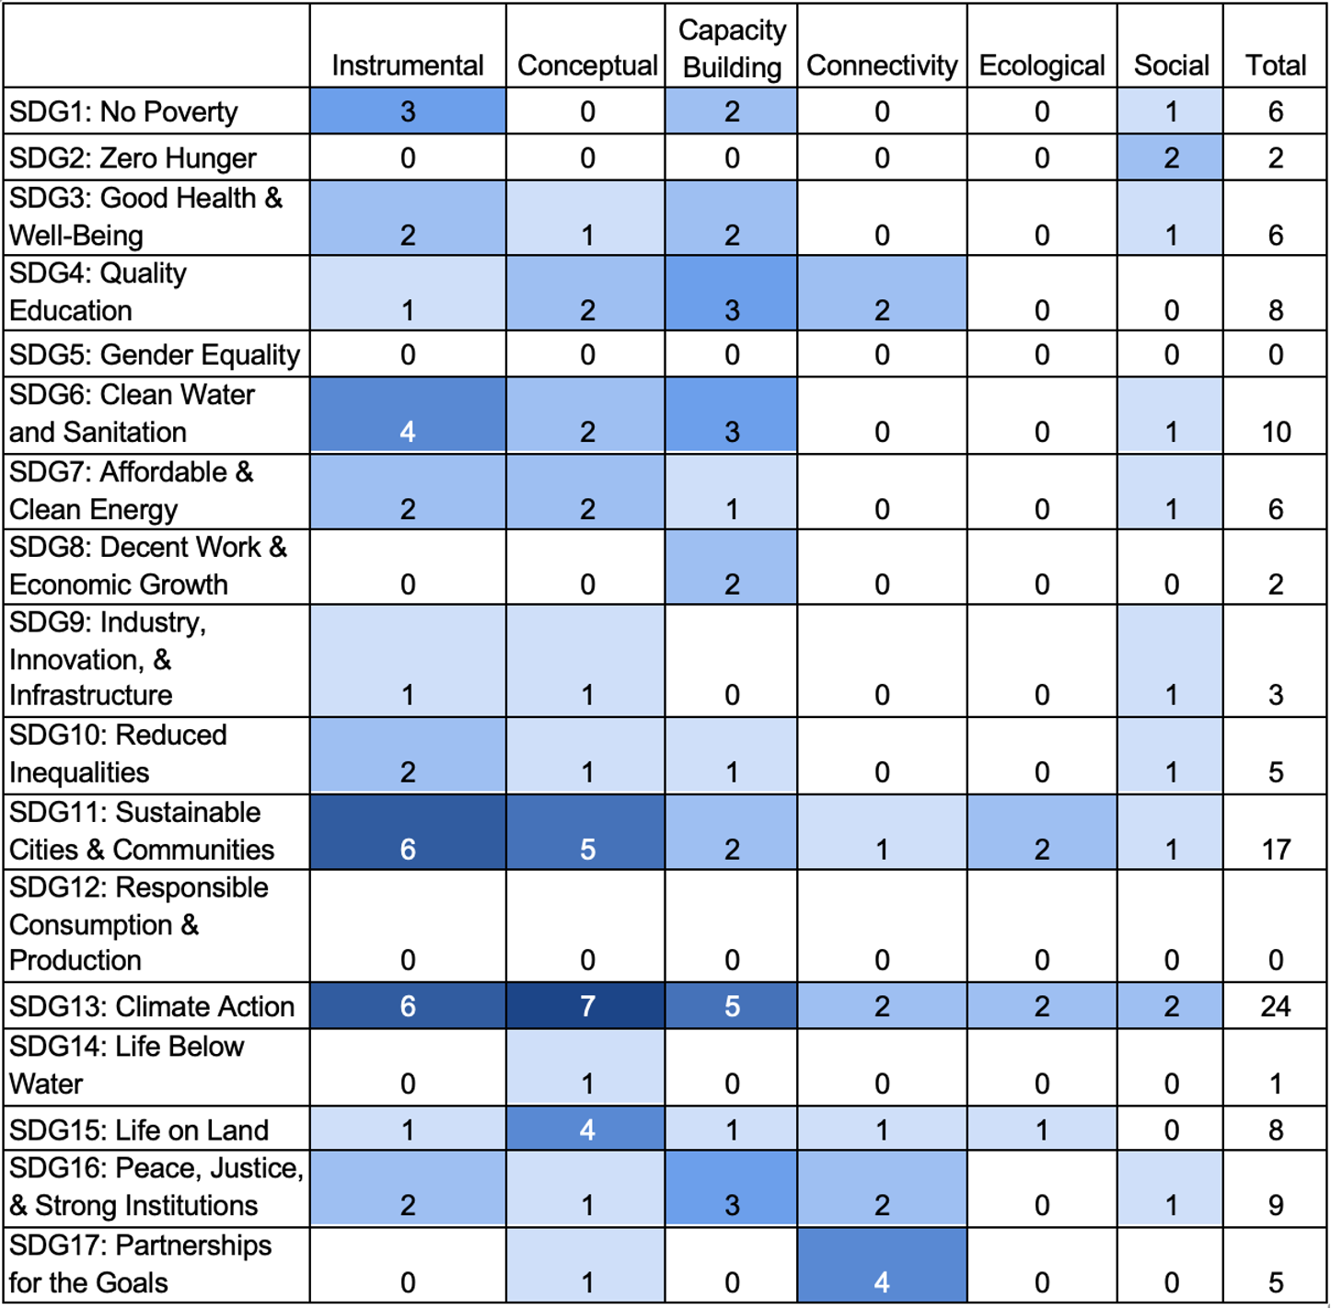
Linking goals and descriptions of change
HOW?
WHAT?
Arizona Institute for Resilience – pilot study of 12 projects
Notes:
Descriptive categories meshed with collective framing
This pulls both ideas together – which sector changed and what kind of change . . .
Categories we introduced above + the SDGs. This allows you to describe

Slide 42
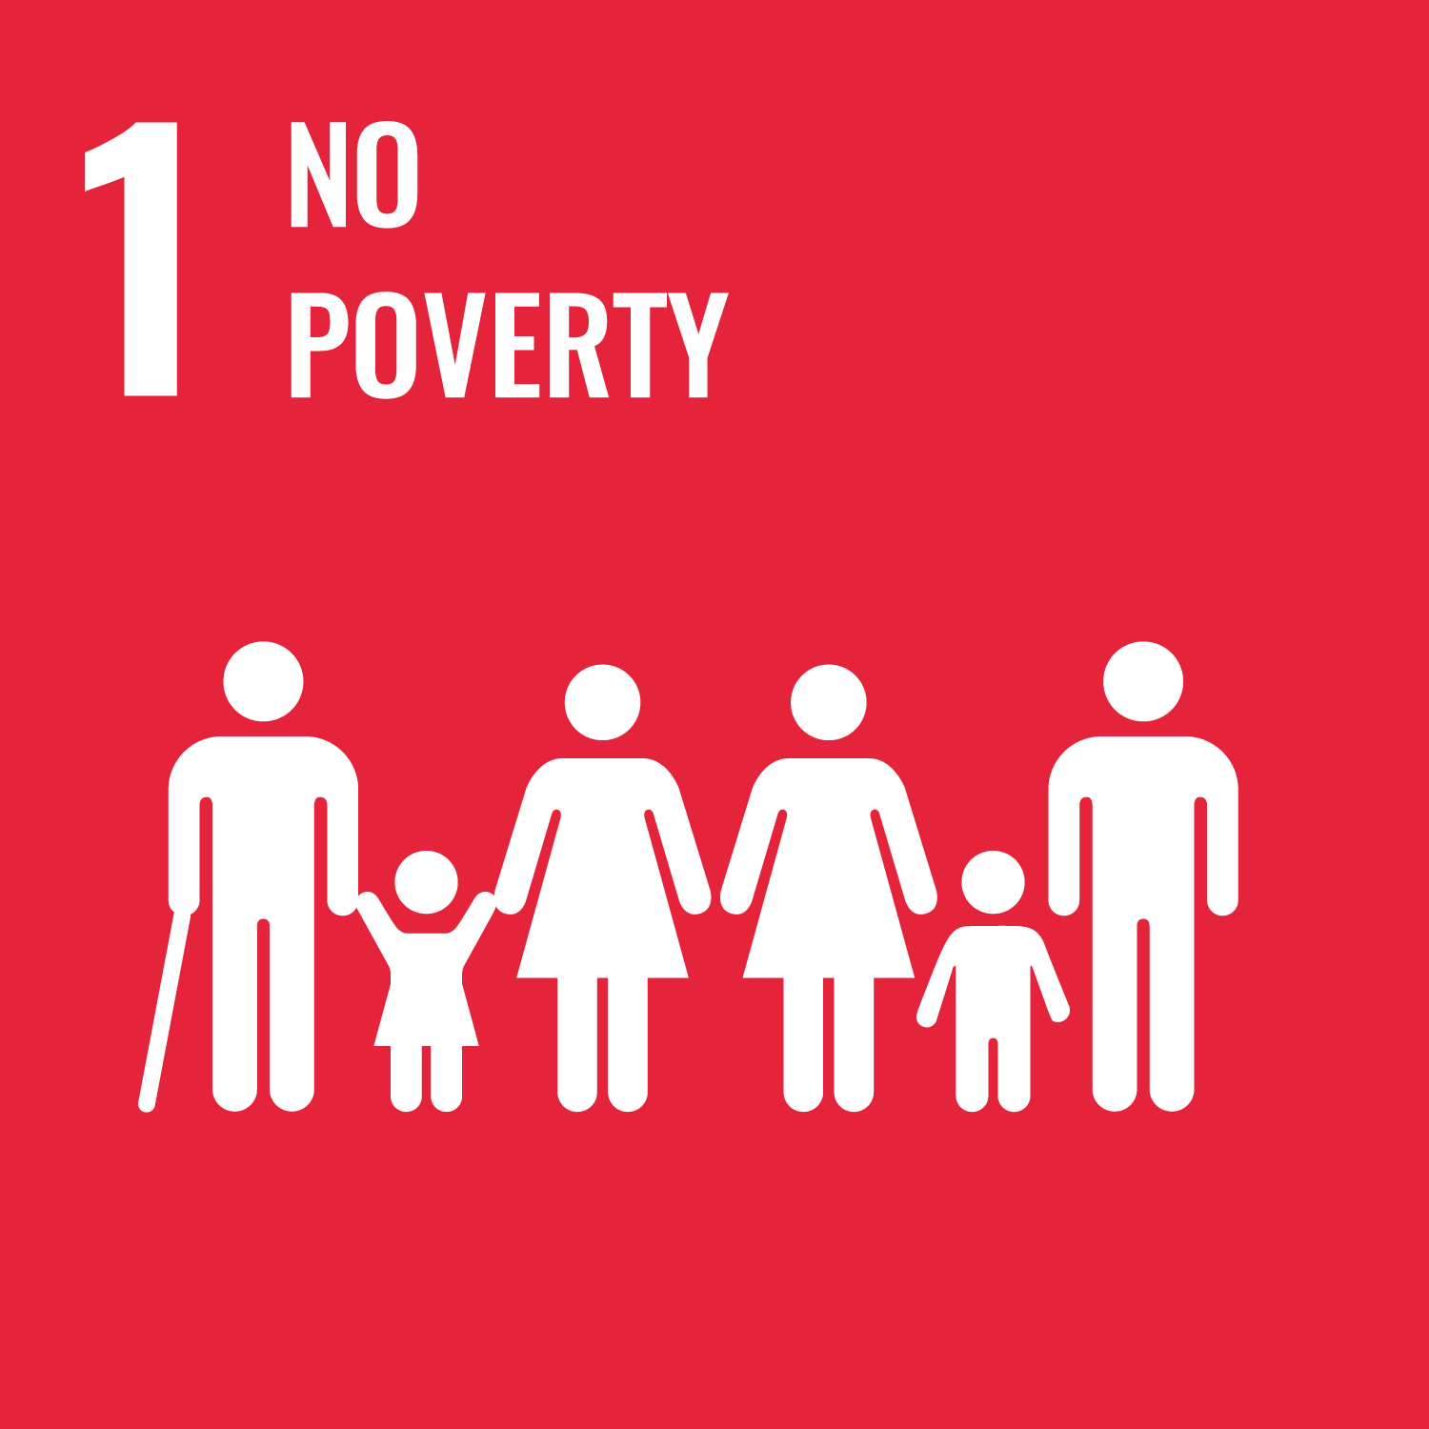
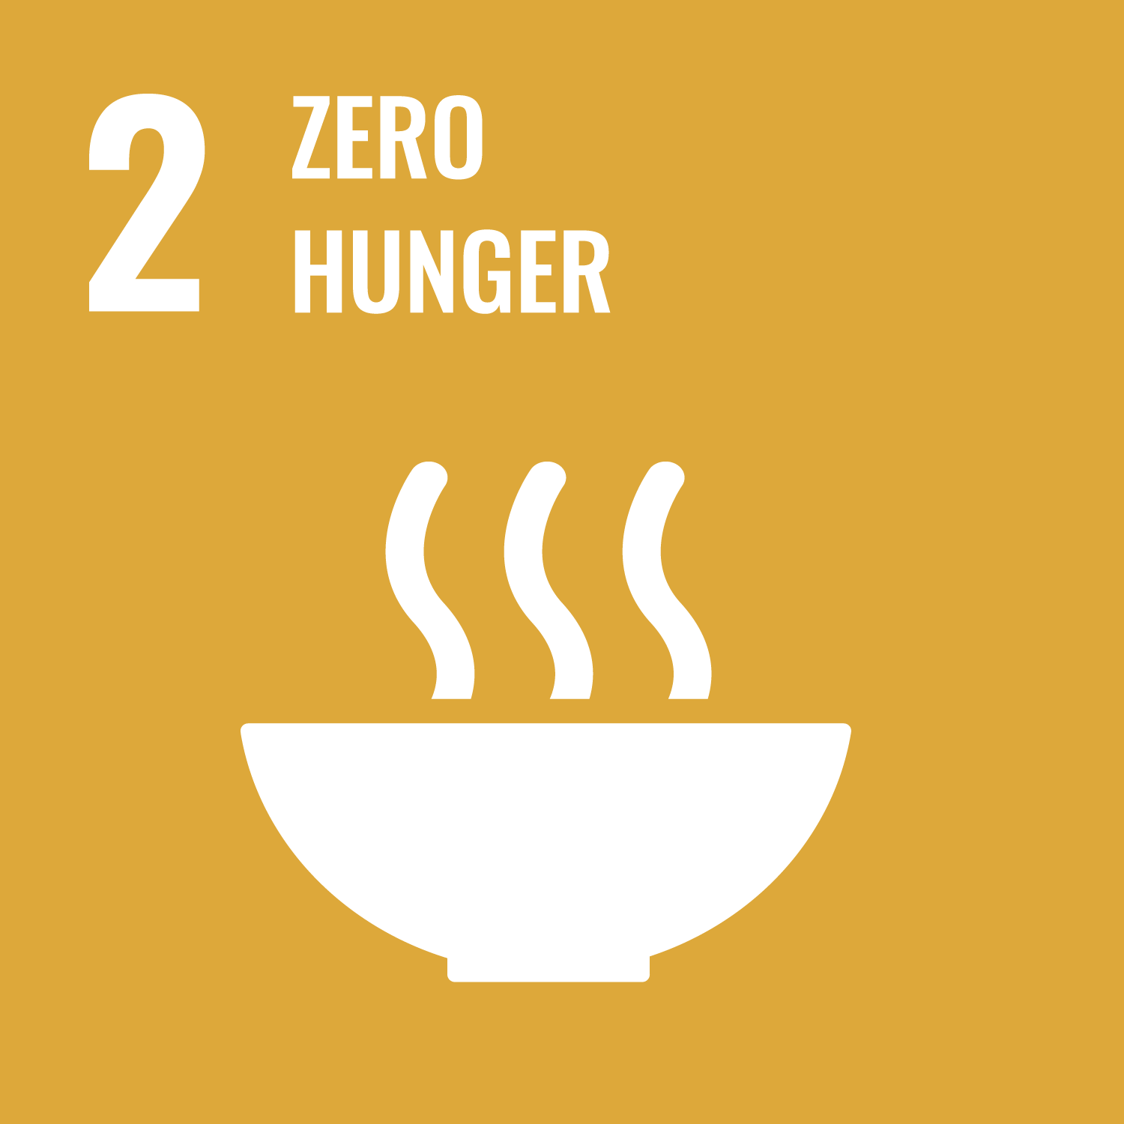
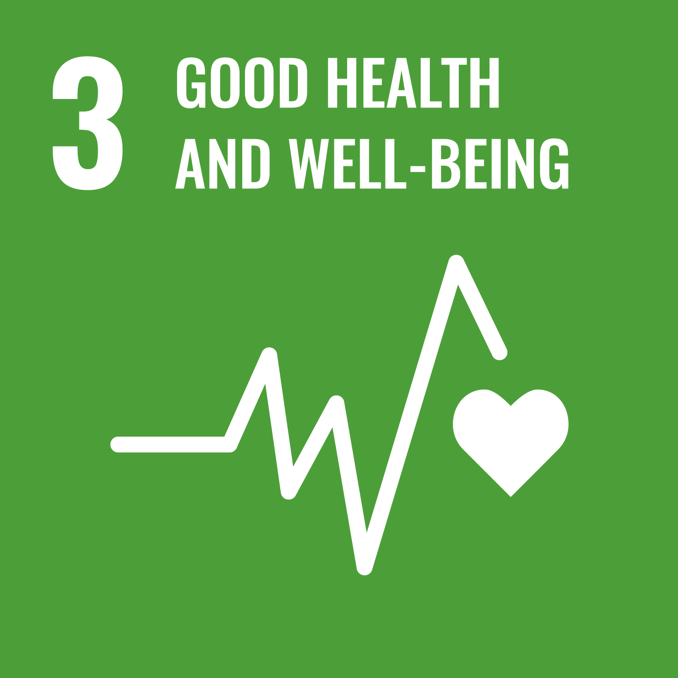
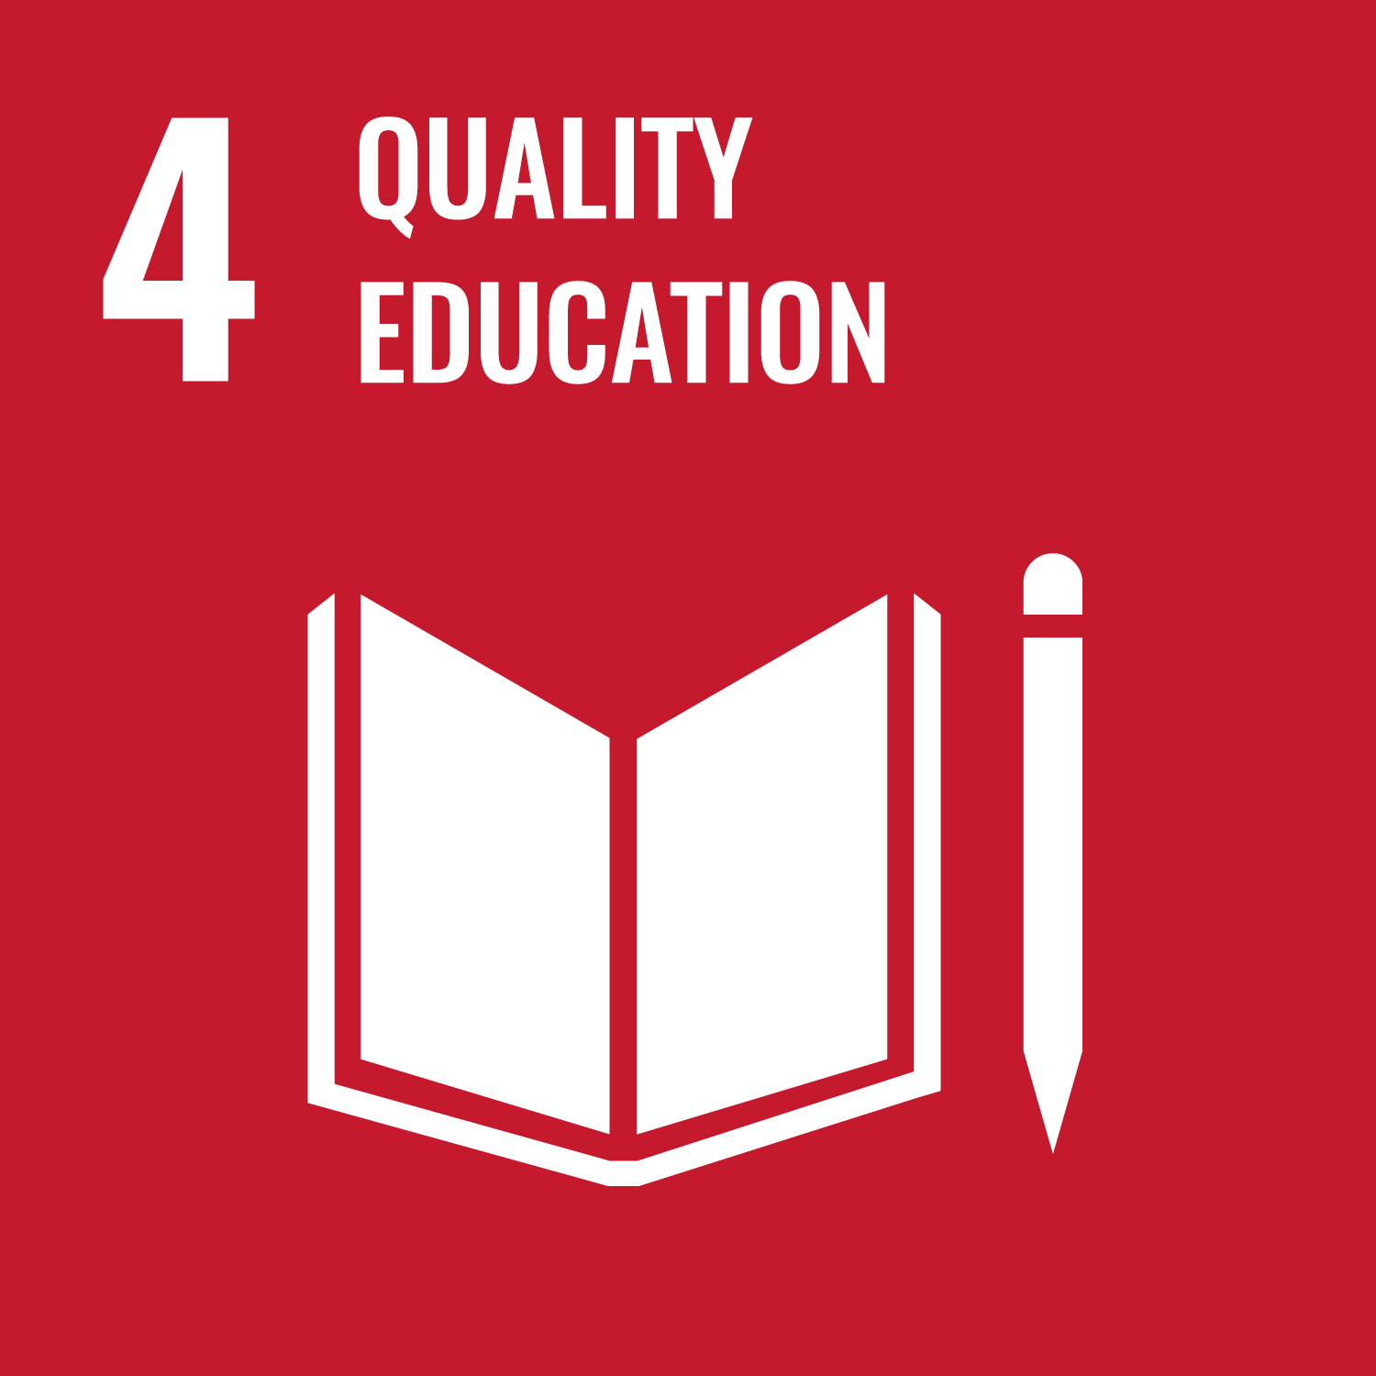
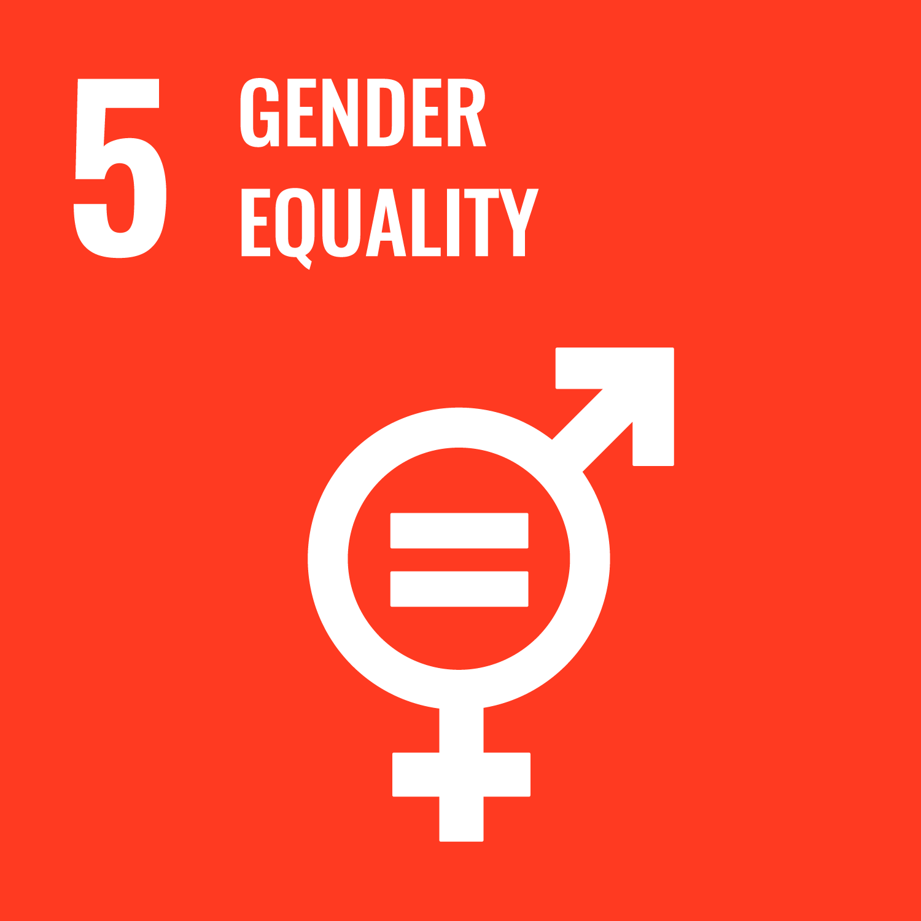
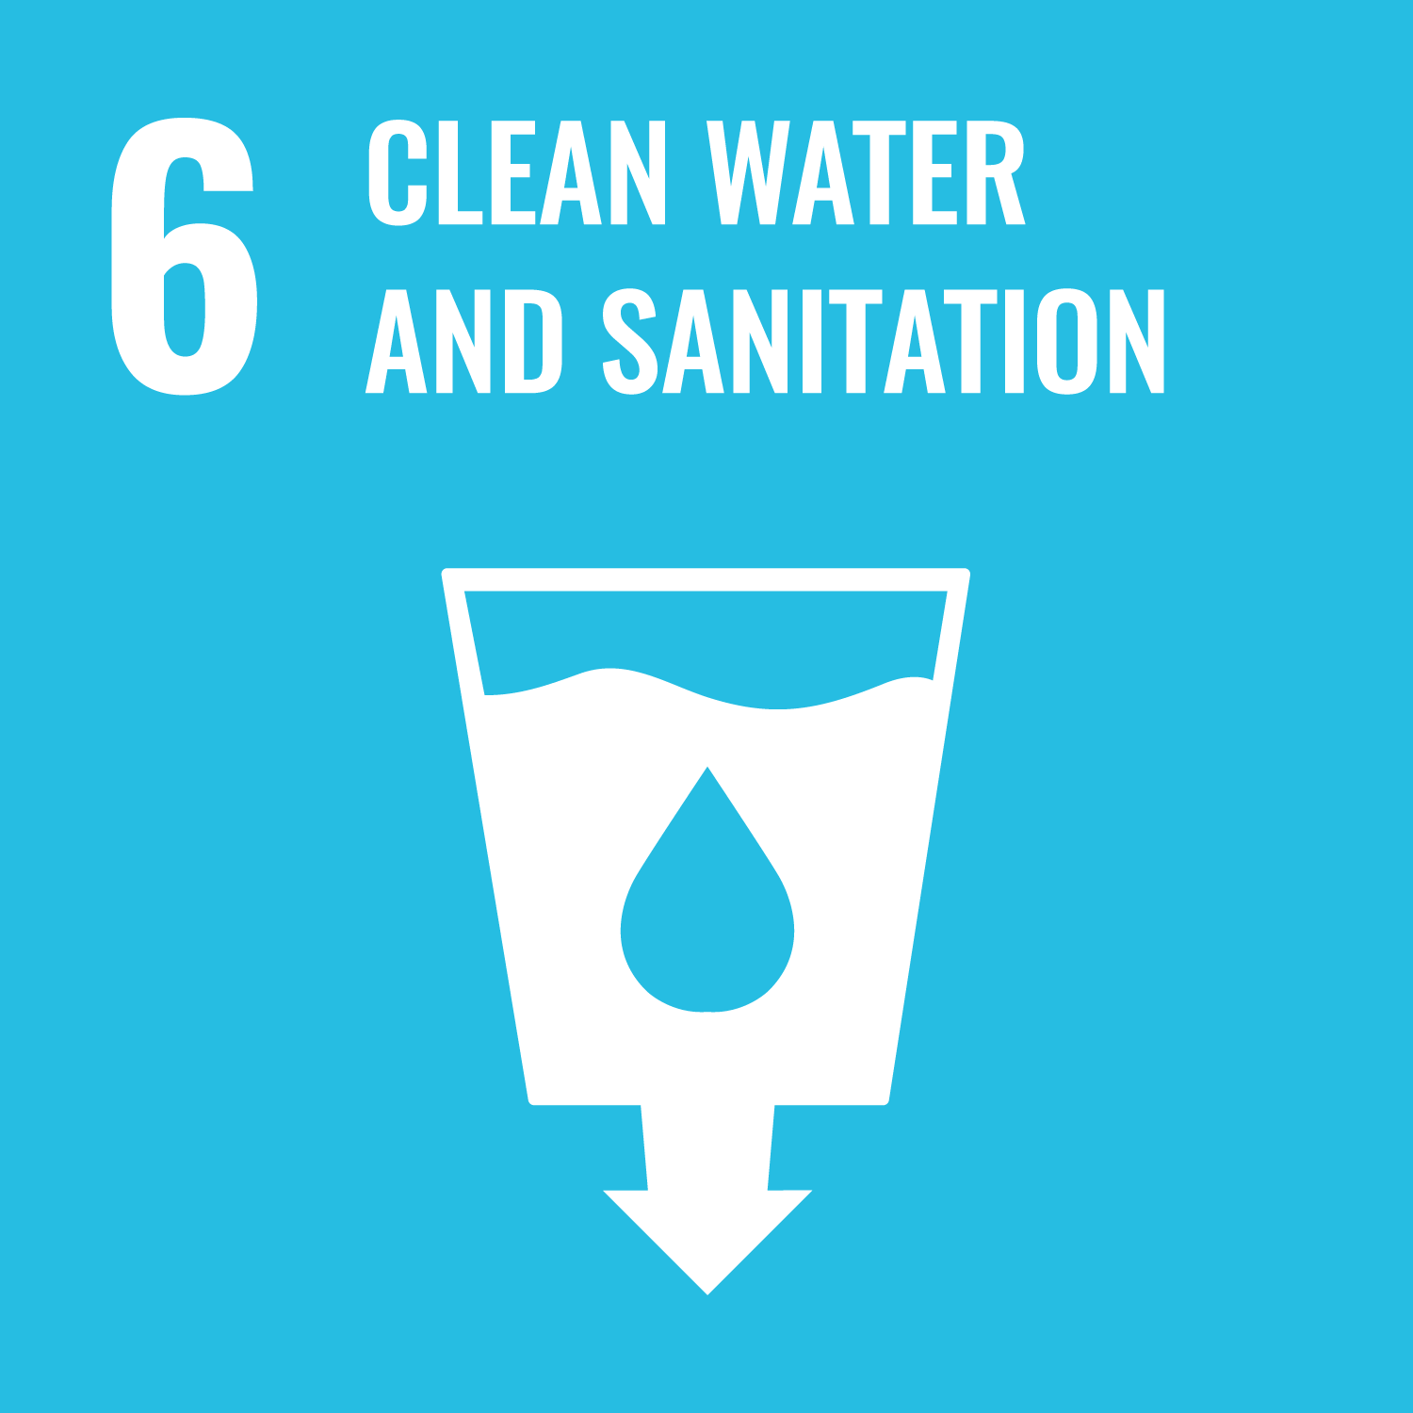
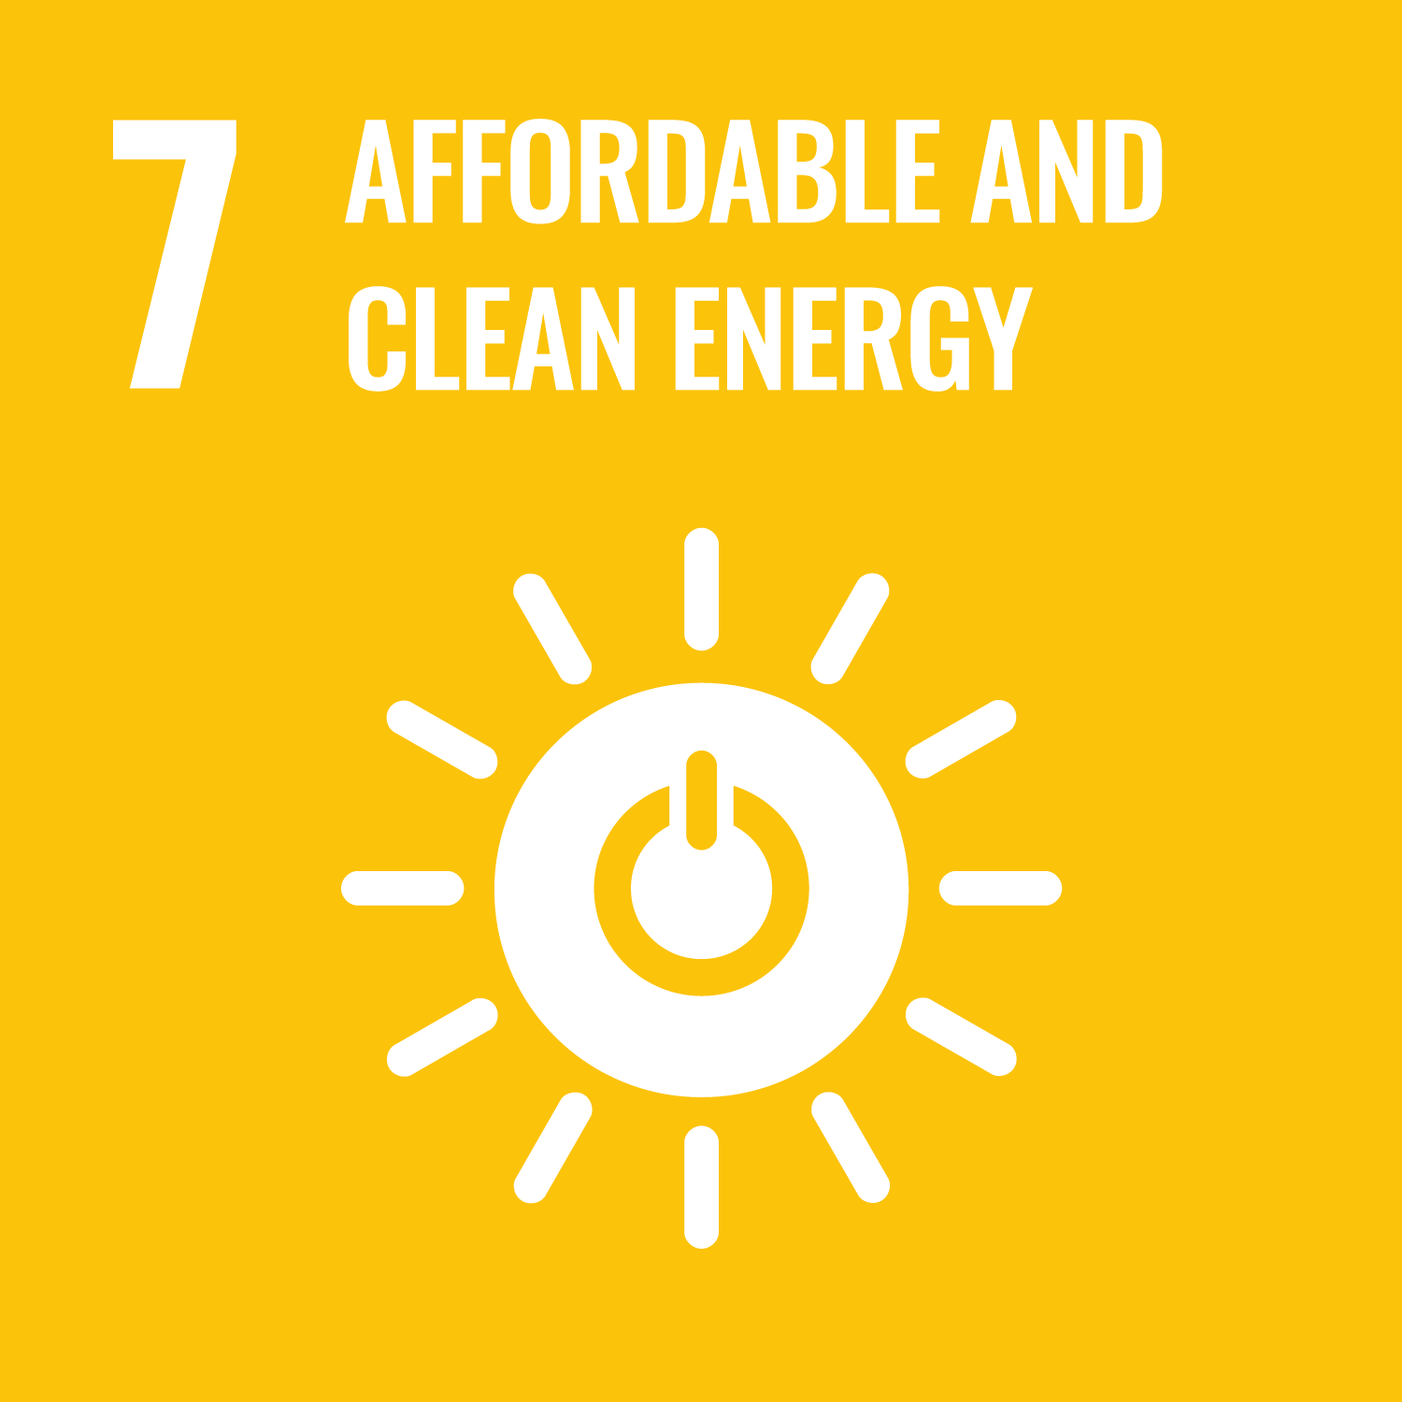
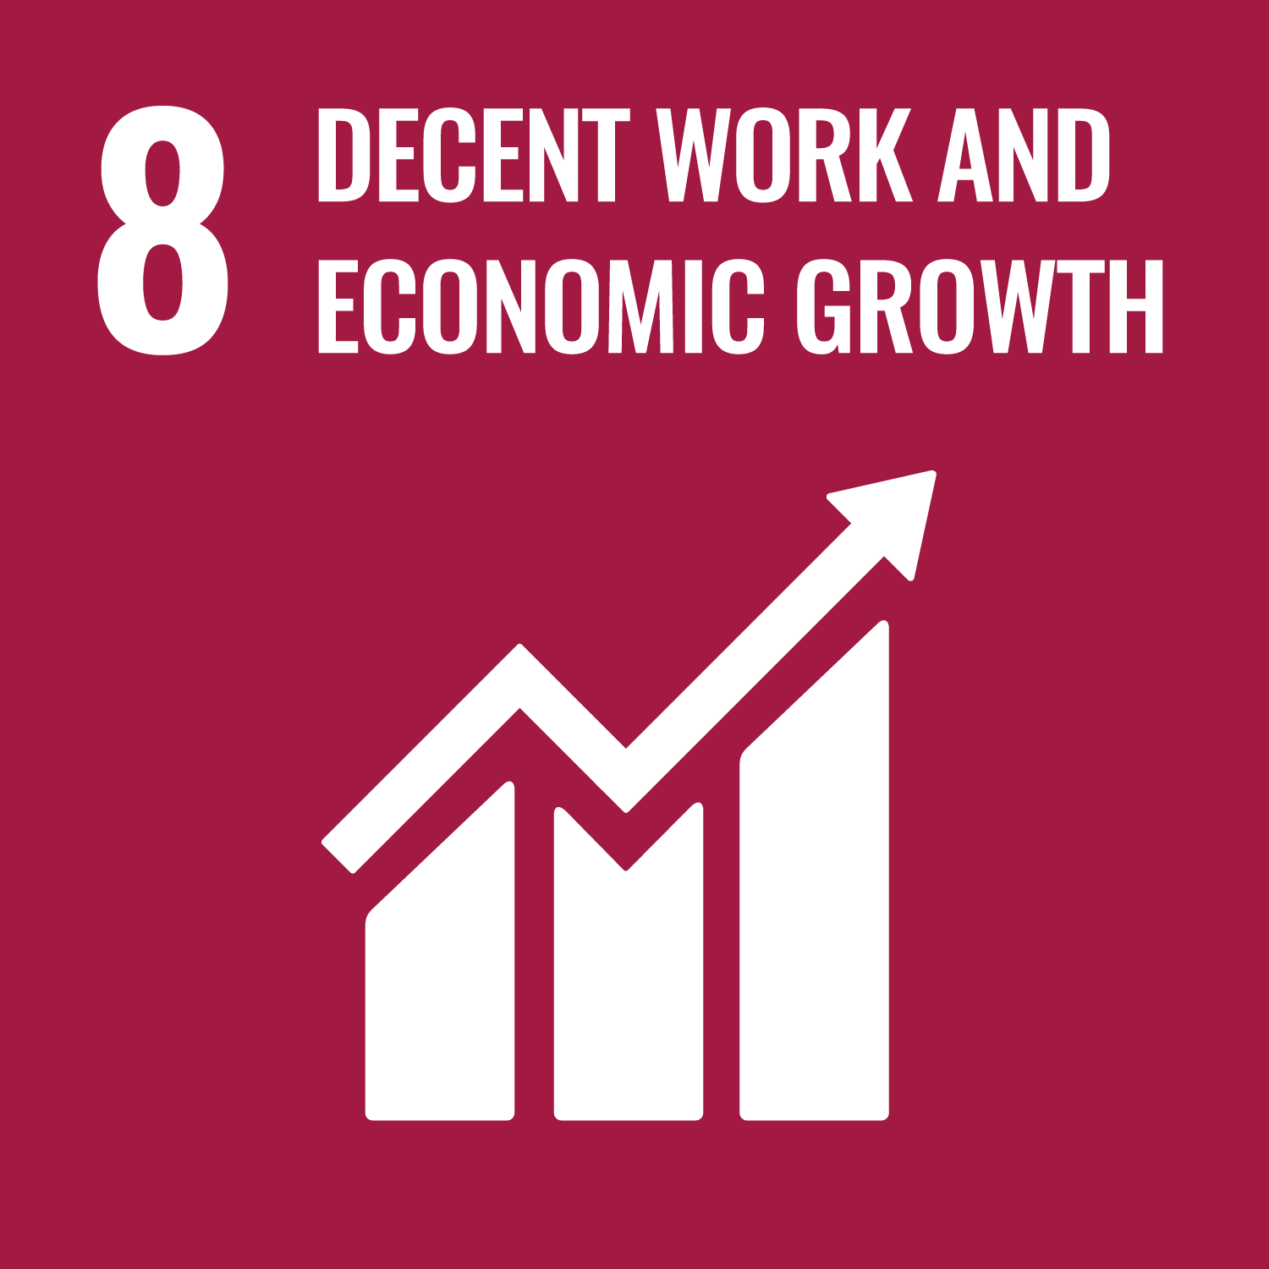
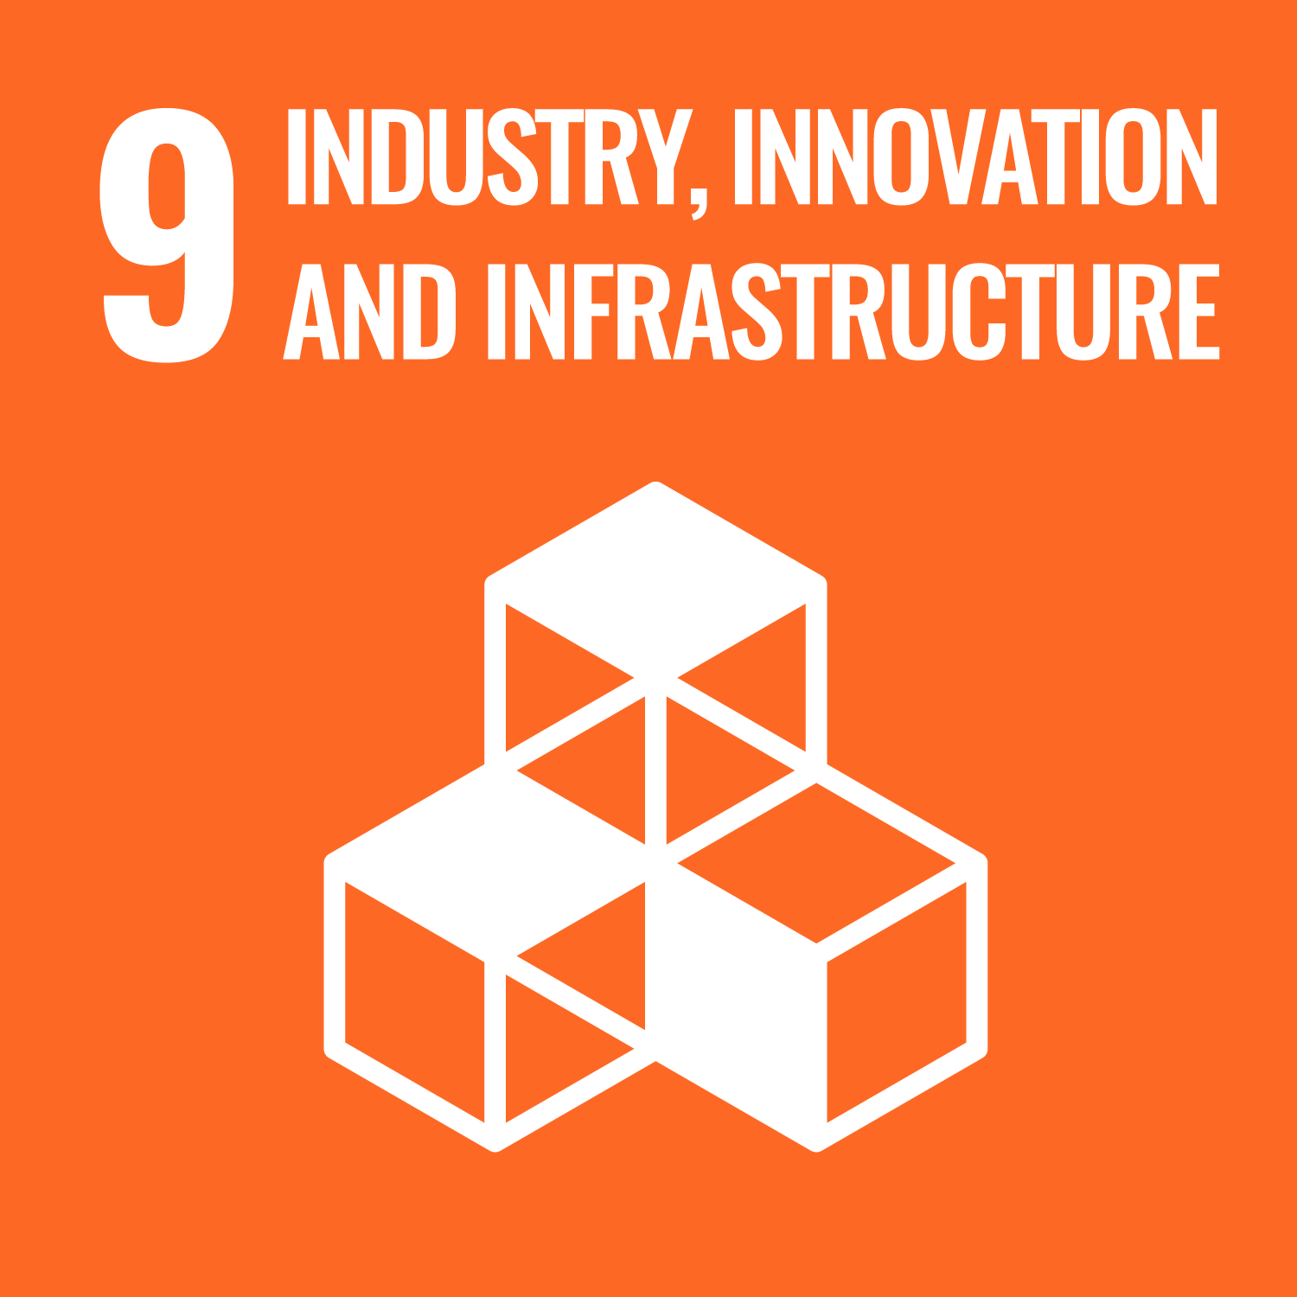
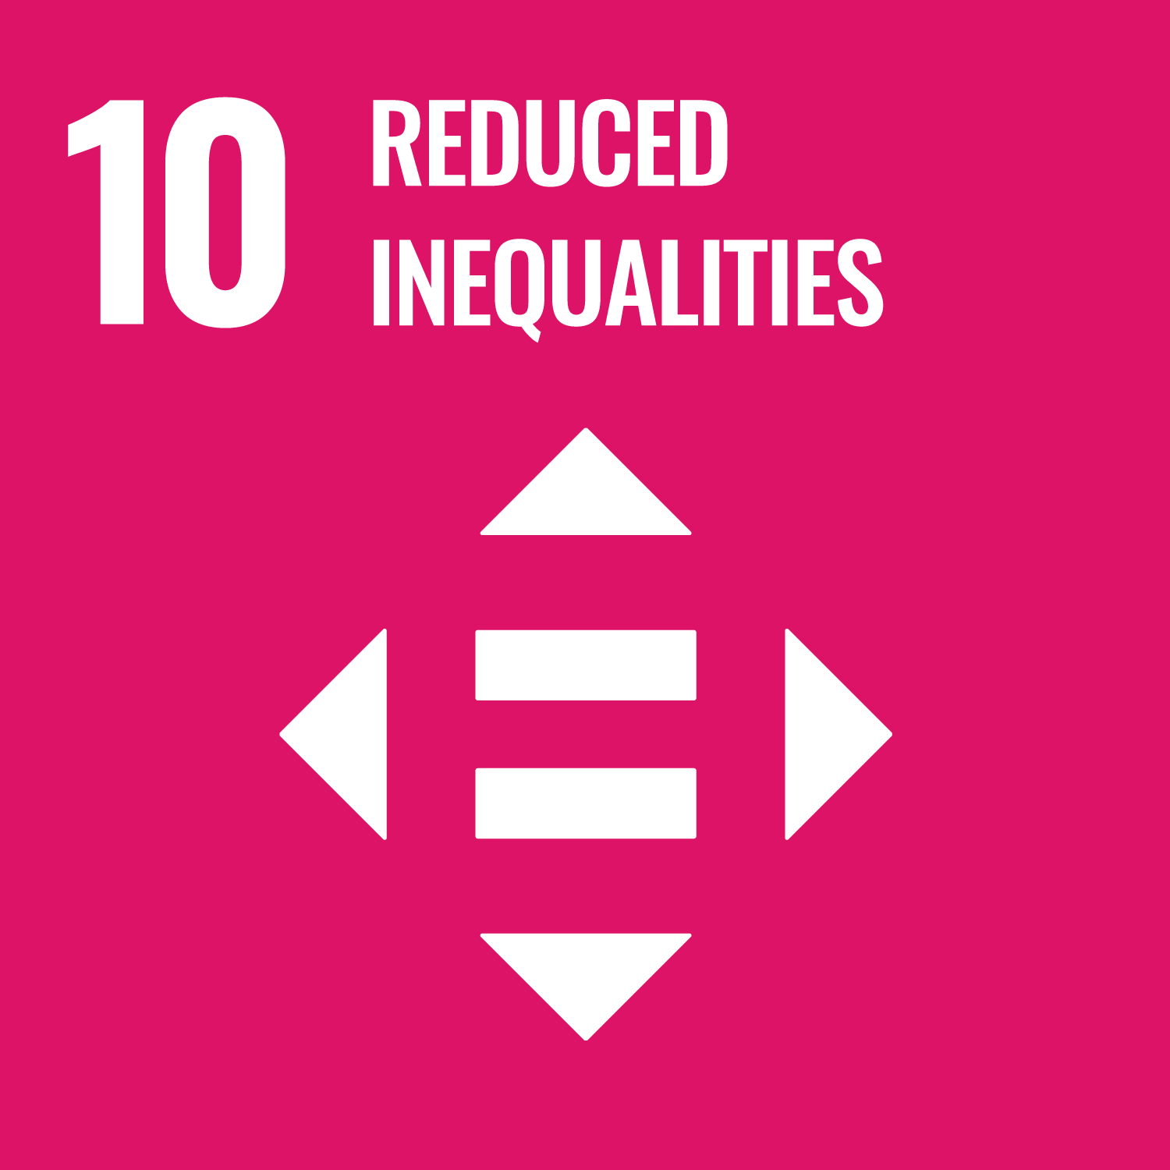
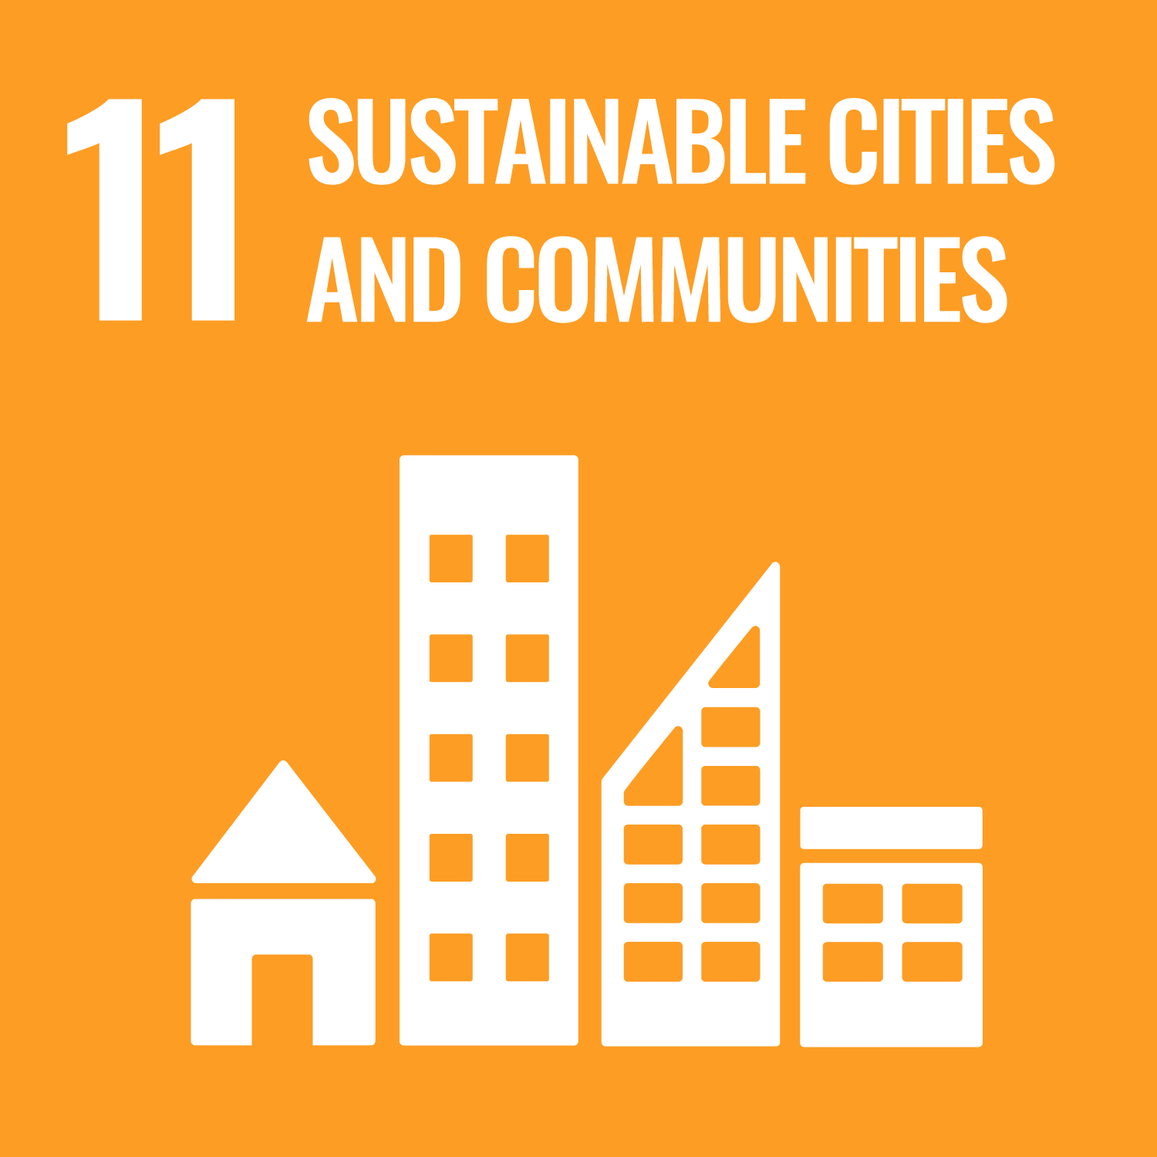
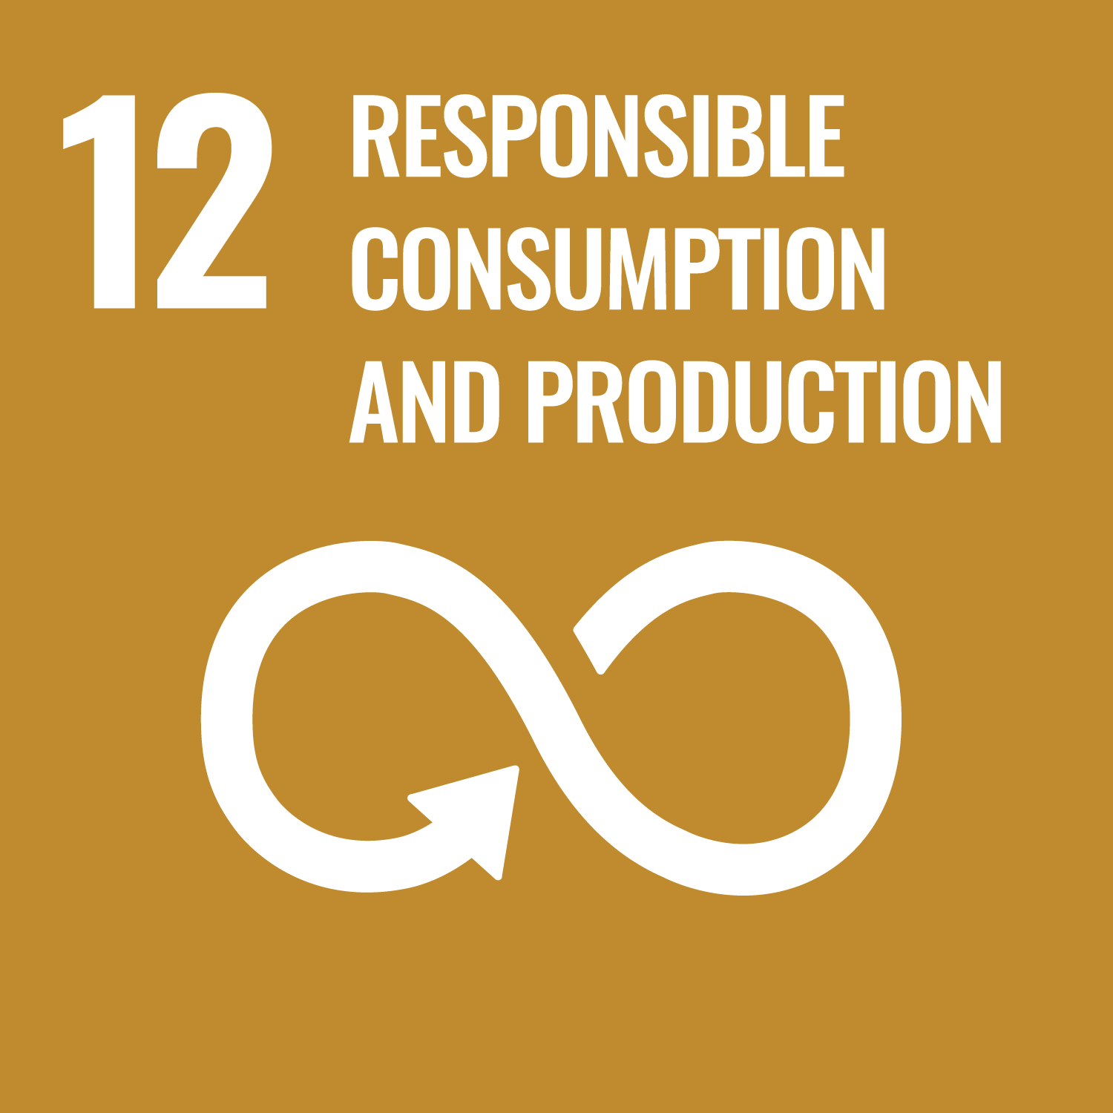
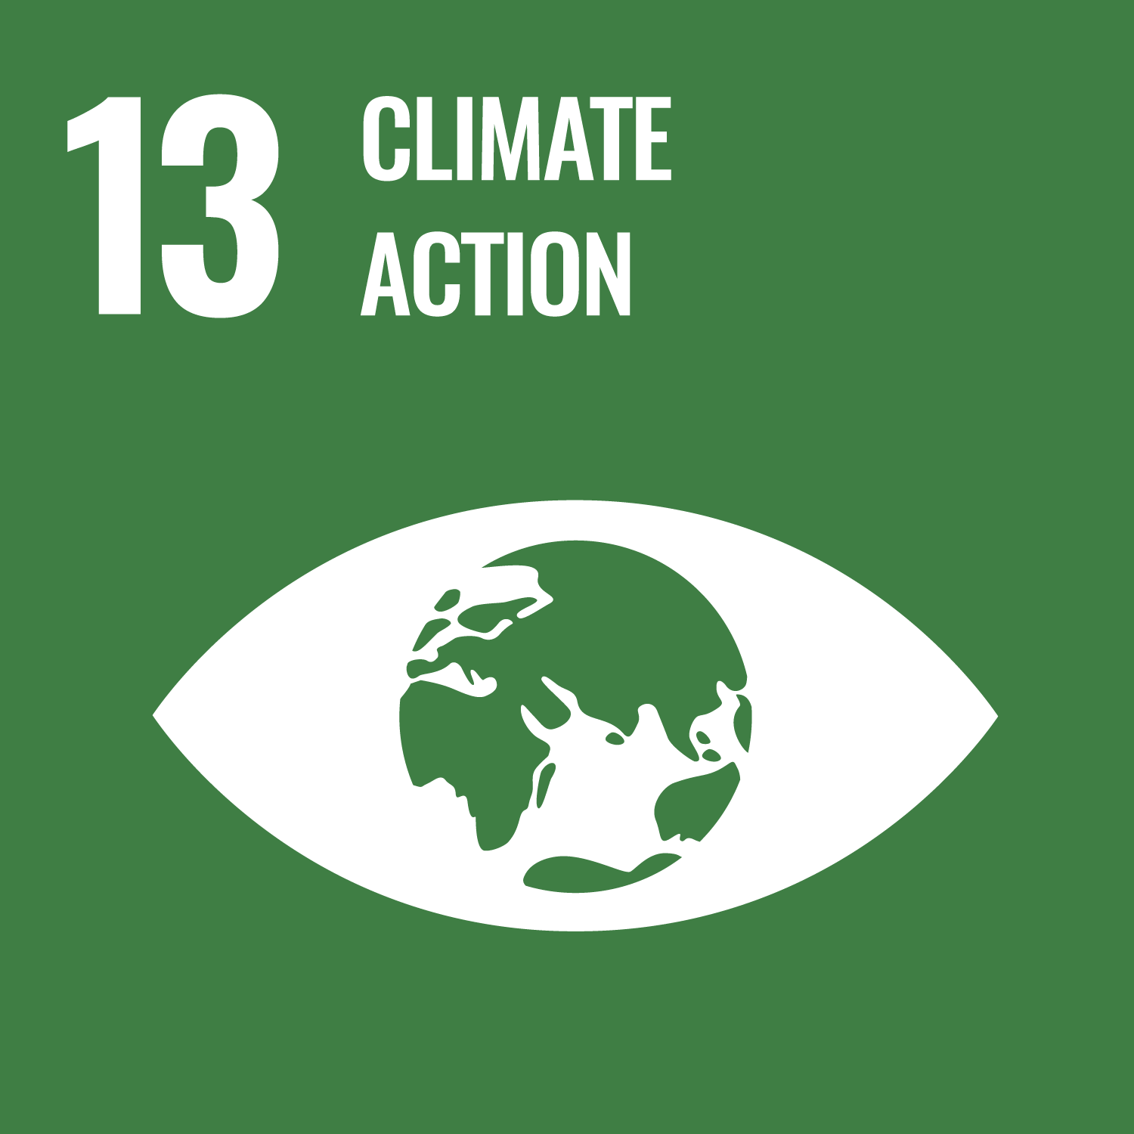
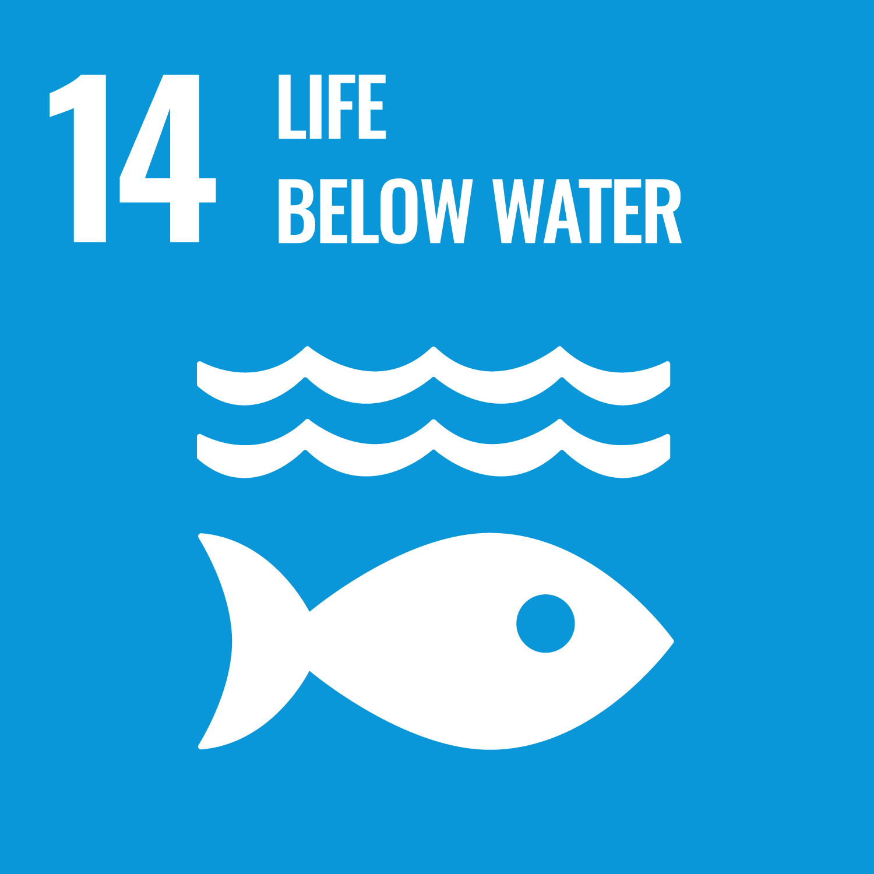
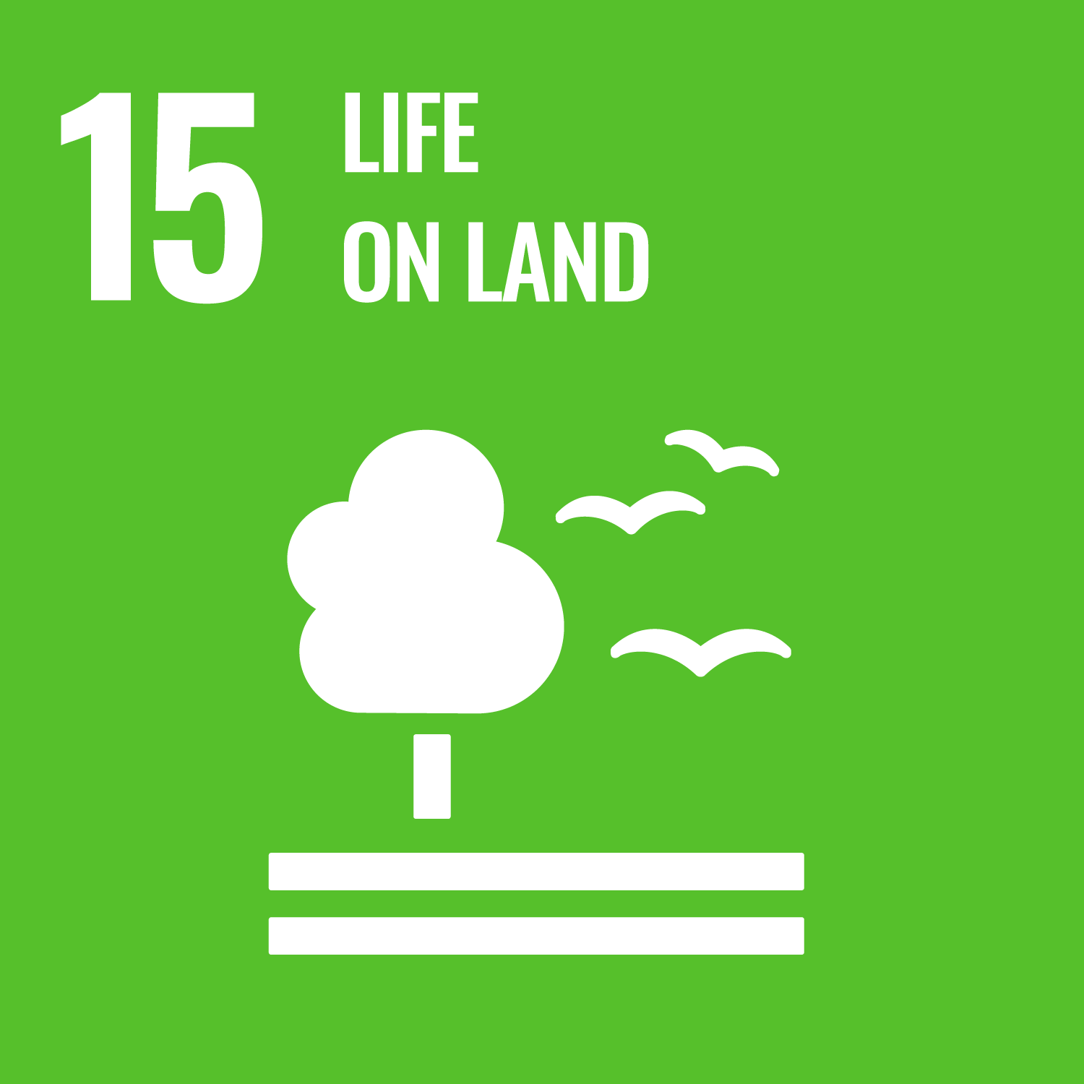

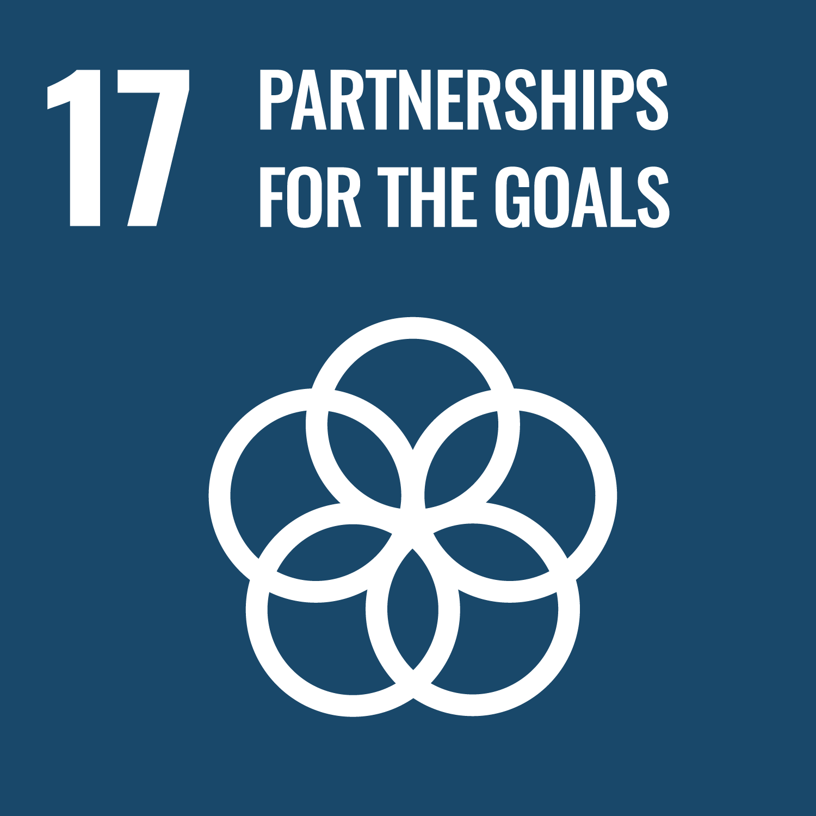
AIR Values about Respect & Belonging; Reciprocity & Service;
Building Community (Good Relationships, Partnerships, and Mentors)
Impact Description | Shorthand
Contributing to changes in plan, practices, policies or actions. | Instrumental Impacts
Contributing to changes in knowledge, awareness, or understanding of the issue in question. | Conceptual Impacts
Contributing to changes in skills, expertise, or resources. | Capacity-building Impacts
Changes to the number and quality of relationships, networks, and trust | Connectivity Impacts
Changes to the researchers’, partners’, and/or the institution’s attitudes toward engaged scholarship/societal impacts | Culture/Attitude Impacts
Contributing to improved social outcomes for partners | Social Impacts
Contributing to improved environmental conditions | Ecological Impacts
Notes:
Conceptually, this is what a societal impacts reporting structure might look like: goals along the top, and descriptors of change (supporting evidence) supporting them.
We asked you about the UN SDGs and found them to be a fairly good fit for this institute.
Lots of work already happening in: 11, 13, 15, 7, and 4 (more than ½ programs are working in these areas already)
Moderate work happening in: 3, 6, 17, 9, and 12 (½ to a little less than ½).
We don't think AIR should narrow in on a smaller subset, though. While it's likely that there will be more examples and more impacts in that first group, the range of work happening here means that it's valuable to have many options for "goals." In fact, we suggest adding an Arts and Culture goal to the list (cultural heritage is also included in 11.4)
Several places to incorporate DEIJ activities and impacts: SDG 16, SDG 10, SDG 5, also in Culture/Attitude Change impacts OR, make the shared values around DEIJ a set of societal goals to strive for.
NOTE: added culture/attitude change because several programs asked about

Slide 43


Next Steps
Element | Question | Examples
Societal Goals | What do we want to contribute to? Is there a problem we can help solve?
Impact Descriptors | How are we contributing to reaching that goal?
Data Sources | Where can we find evidence of our impact? | Feedback and surveys from societal partners Citation in policy documents Monitoring and evaluation studies
Instrumental Impacts
Conceptual Impacts
Capacity Impacts
Connectivity Impacts
Attitude Impacts
Socio-enviro Impacts
Notes:
We are building from what we have learned from other institutions and from our pilot study. We are developing a tool and guidance for University of Arizona that we hope will make it easier for faculty, staff, and students to plan for, execute, and evaluate impactful research.
The idea is to have some of the shared language and shared framework – so we have some common elements that cross all disciplines. But, also allow flexibility so that everyone's particular strengths and interests and context come through.
Three basic elements: Goals – what we're aiming for; Descriptors – How we're contributing; and Evidence of impact – how we *know* we're having impact (or when we're not).

Slide 44

Being Intentional About Your Impact by Attending to the Details
Notes:
Michelle
Thanks! We are going to take a bit of time to dig a bit deeper into being intentional about your research impact, and attending to details.

Slide 45
Impact Intention: Planning
Approach it the same way as your research—with excitement, creativity, rigor and commitment.
Frame your plan as a program—not just a list of activities.
Will you create a brand-new initiative or are there existing programs or initiatives you can work with or build on (and support)?
Think about who you want to partner with and why.
How will your research connect to your societal or broader impact goals & objectives?
Notes:
Here are a few points to consider as you get started:
Approach – If you are not excited, you might want to keep thinking
Frame – In the same way all activities in your research program support your big questions. So rather than a disjointed "to do" list, think about how together, they support your intended impact.
Will – You might notice a gap in an existing initiative that you hope to address, or you might want to expand on and strengthen something that is already working well. Or, you might want to address issues in new and novel ways.
Think – Are they the population or community you want to reach? Or, will they an organization that will help to make connections with the population? Example: if you want to impact learners, you might think about partnering with educators.
How – What are the common threads that run from your research to your impact activities?
I am going to take a small detour here because this last question is typically our jump-off point to a related topic of Developing Your Impact Identity.

Slide 46

Developing Your Impact Identity
Consider this an essential part of your long-term career portfolio, not simply a different ‘statement’ for each proposal you write, or each project
Discovering your impact identity can help you to articulate your impact mission in proposals
Identify what societal impacts are priorities for you – in what ways are you hoping to change the world and why did you choose this professional pathway?
How might your current work actually change the world and for whom?
What people, programs, expertise, partners, institutions, tools do you already have access to that can help you reach your impact goals?
Notes:
Likely you have chosen your research topic because something about it excited you. As you travelled down that research path, you have developed your Research Identity.
Building your Impact Identity has a similar track.
And, as you spend time investigating what excites you about impact, the more your impact will align with your research.
Julie Risien, Organ State University, developed workshops on developing your Impact Identity and supporting materials.
In spring will offer a webinar specifically about developing and documenting your impact identity

Slide 47
Impact Intention: Explore Your WHY
Asking WHY?
Why do I get out of bed each day?
Why did I choose this research field?
Why does my research matter?
Why should anyone care?
Notes:
Michelle
If you get a bit stuck on how your research will connect to your societal or broader impacts, you might consider asking your self these questions about why you started in your research field.

Slide 48
Impact Intention: Explore Your WHY
“I will partner with Girls Who Code to offer a coding boot camp for HS teachers, so that they can feel more comfortable teaching CS courses, so that they can encourage more girls to take CS, so that we get more females as CS majors, so that we have a more diverse CS workforce, so that we have more innovative solutions to society's most pressing issues"
So That Statement
“I will do A, so that B,”
. . .
“so that X,”
“so that Y,”
"so that Z!”
Notes:
Michelle
Another way to explore your Why is through an exercise building a "So that" statement.

Slide 49
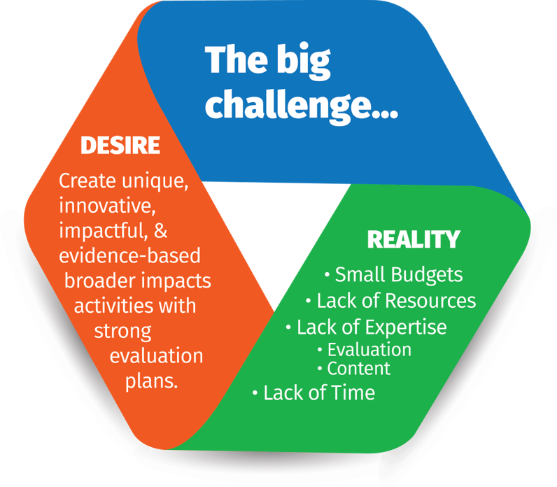
Impact Intention: Program Details
What activities fit between Desire and Reality?
Do activities align with your WHY?
What fits with your department's mission?
What do you want to try?
What do you have experience with?
What resources are required/available?
Will you engage your audience directly?
Will you partner with others?
Notes:
When you begin thinking about your program of activities, we often have a dilemma of what we desire to do and what we can realistically do, especially when the work is connected to our passions.
Graphic:
While we want to create unique, innovative, & impactful broader or societal impact activities, we also have to think about our budget, resources, gaps in expertise, and time constraints.
Next:
You can ask yourself questions to help with your planning:

Slide 50
Impact Intention: Partnerships Details
Think broadly about who has a vested interest, different perspective, or community influence.
Talk to a variety of community voices.
Consider partner/community needs – it’s not just about the researcher’s needs, wants, etc.
Identify partnerships early and onboard them during the planning period – not at the last minute.
Recognize if more partnership work needs to be done before moving forward.
Notes:
So let's talk a bit about partnerships, as this is the core of planning your societal impact:

Slide 51
Impact Intention: Partnership Activities
What activities fit between the shared Desires and Realities?
Do activities align with our WHY?
What fits with our missions?
What do we want to try together?
What do we have experience with?
What resources are required/available?
Are the activities appropriate for our target audience?

Slide 52



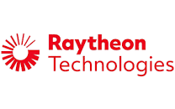


Impact Attention: Partnerships
Begin with Existing Relationships
K-14 educators
Informal educators
Industry or commercial partners
Civic, community, spiritual leaders
Other professional
Notes:
Michelle
When thinking about Partnerships, think about who you are already connected to, how would they be impacted by the research, and how.
Example of working with the Solar guiild.
SOlar Guild, apprentices, NASA Space grant student – TEP,

Slide 53
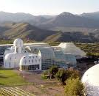
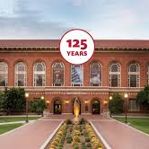
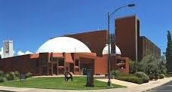
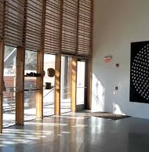
Impact Intention: Partnerships
Begin with Existing Resources
  Science Centers
  Poetry or Photography Centers
  Existing Café's or Lecture Series
  Academic or Industry Laboratories
  Museums
  Nonprofits
  Industrial Centers
  Government agencies
Notes:
2:02
Michelle
Biosphere2
Flandrau Science Center
Center for Creative Photography
Poetry Center
Arizona State Museum
COS Science Café Lecture Series
UA Art Museum
Tree Ring Laboratory
Mt. Lemmon Sky Center
WISE, SHPE, ASEMS, EAO
Government agencies – federal, tribal, state, municipal

Slide 54
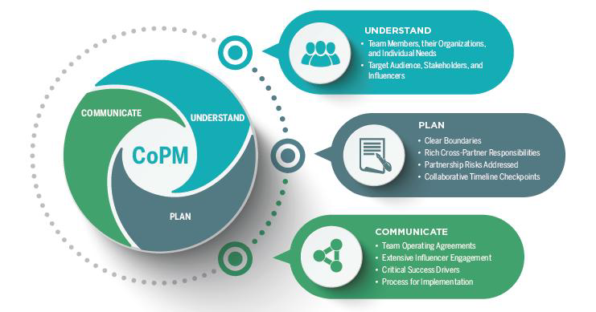
Impact Attention: Partner Considerations
  Important to Discuss/Resolve:
  Our Goals, Your Goals, My Goals
  In-/Out-of-Scope items
  Roles & Responsibilities
  Expectations
  Risk Management
  Timeline(s)
  Communication
  Decision making and documentation
  Stakeholder management
Collaborative Project Management (CoPM)
Playbook
for Multi-Organizational Teams
Notes:
2:00
Michelle
think about what is relevant in your field and related to your specific activities

Slide 55
A thought to ponder . . .
How do you know if your work is having the impact you want?
Notes:
Michelle

Slide 56
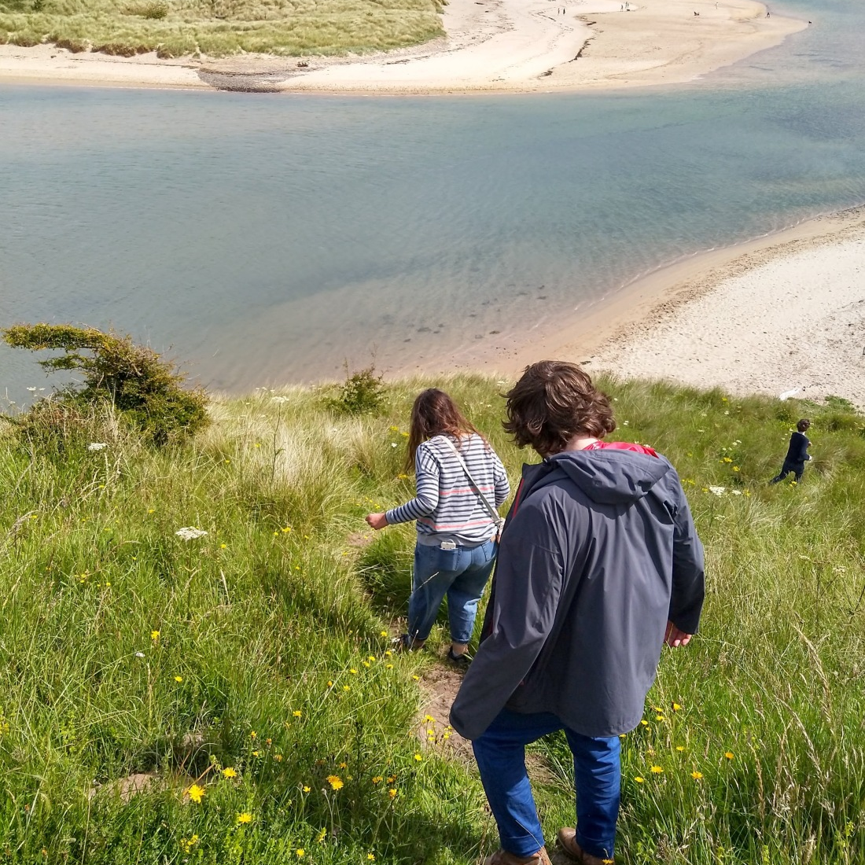
Assessing Impact
Question to Consider:
To what extent do our activities and partnerships produce the intended changes or outcomes in society?
This Photo by Unknown author is licensed under CC BY-SA-NC.

Slide 57

Notes:
A logic model is a common tool to help determine whether your planned activities will produce the intended impact.
This is a common one we use,
The far left defines the situation, the problem, the mission, or mandate.
The next column under the yellow heading of INPUTS lists the required resources, including human resources.
The three columns under the green heading, OUTPUTS, outlines the participants, your activities, and the products created out of your program.
The final three columns define the short, intermediate, and long term outcomes your expect to achieve. This is what you will want to assess.

Slide 58
Evaluating Societal Impacts
We need to go beyond addressing a particular problem
We want to demonstrate that we’ve contributed to solving a problem – that some kind of demonstrable change has occurred
Outputs in-and-of themselves are not the source of change (although that can be indicators and contributors)
Research findings can help propel change – so can the *process* of doing the research, particularly when we are engaging with societal partners

Slide 59

Modeling the Process
Curricula
Notes:
Gigi
In the guidebook we demonstrate how to link research processes to impacts in two main ways. We walk through planning for societal impacts through project development and design, in the early stages of a research project and also walk through how to assess and document societal impacts after a project has ended. They use similar structures and questions but are slightly different in scope and purpose. Today we will focus on the process to document impact after a project has ended.
Our framework is based on an action logic model format. For each step, we include specific questions and directions to help researchers think through and outline their impacts.

Slide 60
Who changed because of your research?
Stakeholders:
Community Partners
Policy Makers
Industry Professionals
Practitioners
Government Officials
Students:
K-12
Undergraduates
Graduate Students
Continuing Education
General Publics:
Residents of a City
Interested Parties
The demographics of the people impacted by your research is important
Notes:
Gigi
There are multiple ways to think through this question of for whom things changed or improved because of your research. Some common categories include stakeholders or your research partners, students, and the general public
Going through this part of the process offers opportunities for reflection. Are you actually reaching the people and communities that you hope to reach?
If you are centering justice and equity in your research, this component is crucial. In the case of Floodsville, for example, if the community you worked with had been historically ignored and left out of city policies or consistently underfunded by the city, the impact of developing a mitigation plan to address flooding in this community and the impact of strengthening relationships between city planners and community members in that case becomes even more significant.

Slide 61

How do you know? Evidence of change
Feedback from your partners
  Formal (letters of recommendation or partnership)
  Informal (email or phone calls)
Reference to your work in a management/policy document
  Research findings forming the basis of policy document
  Citation in management reports or publications
  Check Altmetric or Overton to find your citations
Feedback from the general public
  Audience surveys
  Emails or other engagement from public
  Media interviews/reference to your work
Formal evaluation of your work
  Pre-post tests
  Surveys/interviews of partners
  Randomized control trials
Notes:
Gigi
There are lots of ways – formal and informal – to collect evidence of change. A lot of these just require that you think ahead about what you are likely to see, how you will collect and save that data, and how you’ll incorporate it into a case study.
Jen just provided a number of ideas for evaluation data collection. This is just a reminder that the key is to be consistent and make sure that you are collecting and saving these examples.
Keep an impact journal!
You might not be the one collecting the data. There might be other sources out there that someone else is collecting (community newsletters, news report, UAIR)
Expanded stakeholders – who else who has been involved might have ”evidence” you can look at . . .
Remind people that their partners can be an excellent source of data about impact - they might be collecting that data for their own or other purposes and might be happy to share it. Nonprofits are often collecting all sorts of evaluation data, for example. Her framing is that this is another way to think of partners as actual partners - not just as beneficiaries of research or participants in activities. Collaborate on the evaluation of the project as well as on the activities.

Slide 62

Resources

Slide 63




Training
Partnerships
Scholarship
Notes:
Jen
NSF funded Center for Advancing Research Impacts in Society
Founded in September 2018 and housed at the University of Missouri
We work with U.S. and international scientists and engagement practitioners to build capacity, advance scholarship, grow partnerships and provide resources to help them engage with and demonstrate the impact of research in their communities and society.
Identification and curation of promising models, practices, and evaluation methods for the Broader Impact (BI) community;
Expanded engagement in and support of the development of high-quality BI activities by educating current and future faculty and researchers on effective BI practices;
Development of the human resources necessary for sustained growth and increased diversity of the BI community; and
Promotion of cross-institutional collaboration on and dissemination of BI programs, practices, models, materials, and resources.

Slide 64


Professional Development
Since 2018, ARIS has offered more than 150 events involving more than 7,000 participants.
ARIS has offered an extended series of trainings and meetings with three ORIC cohorts that have involved 28 institutions and 34 administrators and 59 BI professionals.
ARIS shares resources and news with the more than 1,600 community members who subscribe to the ARIS newsletter.
BI professional:
"ARIS has given us templates of BI trainings we can deliver to our campus researchers and a strong network of BI partners who can answer any questions as we begin to elevate BI at our campus.”
Researcher:
“I firmly believe their (ARIS) workshop helped me land my NSF award (also the first one I ever applied to), so I would like people to know how ARIS is an asset to researchers applying to NSF.”

Slide 65

ARIS Resources
Program to Enhance Organizational Research Impact Capacity (ORIC)
Institutions and organizations participating in this year-long program receive training, resources and mentorship that will allow them to substantially enhance their internal capacity to support research impact.
BI Toolkit and Resource Development
Broader Impacts Review Document for NSF Proposals
BI Planning Checklist
BI Wizard
BI Evaluation Rubric
Broader Impacts Certification & MicroCredential
Module topics include:
  BI Foundations
  Writing an Effective BI Plan
  Faculty Development in BI
  Building Strong Partnerships
  Broadening Participation through BI
  Evaluating BI

Slide 66




Strategic Initiatives
Program to Enhance Organizational Research Impact Capacity (ORIC)
Institutions and organizations participating in this year-long program receive training, resources and mentorship that will allow them to substantially enhance their internal capacity to support research impact

Slide 67


Strategic Initiatives
Broader Impacts Certification & MicroCredential
Participants tested and completed portions
of the ARIS Certification Program during the half-day session at 2023 ARIS Summit Pre-conference.
Module topics include:
  BI Foundations
  Writing an Effective BI Plan
  Faculty Development in BI
  Building Strong Partnerships
  Broadening Participation through BI
  Evaluating BI

Slide 68

https://aris.marine.rutgers.edu/wizard/
Notes:
Jen

Slide 69


Checklist and Guiding Principles
Notes:
Jen

Slide 70

https://aris.marine.rutgers.edu/wizard/
Notes:
Jen
Slide 18: Tour the Site - Join me at https://aris.marine.rutgers.edu/wizard/ - watch 4 minute intro.

Slide 71

Wizard Objectives:
Support early career researchers in developing Broader Impacts projects.
Expedite facilitation of BI meetings with researchers
Collection of effective practices in one product
Case studies that illustrate effective practices and a career trajectory of
doing BI
Notes:
Jen
My team at Rutgers developed this online tool to help capture our lessons learned during COSEE and develop an enduring product that could help oceanographers develop and implement effective BI plans.
We wanted to:
Support early career researchers in developing Broader Impacts projects.
Expedite facilitation of BI meetings with researchers
Collection of effective practices in one product
We also developed a professional workshop called the Gears to Scientific Success – that used the Wizard and added post award skills like science communication 101, a crash course in how people learn and the importance of Broadening Participation.

Slide 72

Non linear BI Plan Elements
Notes:
Jen
Slide 17: Design Features to notice when you tour the site
These pages can be used ala carte as “training” and fact finding on particular elements. Lets take a quick walk through these elements:
Non linear plan elements page
Video tutorials
BI examples built in to provide additional guidance (“teach one, do one” model)
Integration of checklist
Fillable fields for notes
Summary page that pulls all your notes together
New interactive game to help inform budgeting and understanding cost of traditional BI projects

Slide 73

BI Rubric @ https://aris.marine.rutgers.edu/wizard/rubric.php

Slide 74




Now accepting proposals!
Keynotes: Dr. Alicia Knoedler,
Dr. Nalini Nadkarni and more!
Preconference with co-host,
SOSI Center - The Louis Stokes
Regional Center of Excellence
for the Study of STEM
Interventions
Partnering with the Omaha Zoo!
Registration and ARIS award nominations open soon!
researchinsociety.org/summit-2024

Slide 75
Additional Resources
Office of Societal Impact: Research Impacts Project https://impact.arizona.edu/research-impacts-project
Planning and Evaluating the Societal Impacts of Climate Change Research Projects: A guidebook for natural and physical scientists looking to make a difference. http://doi.org/10.2458/10150.658313
The Guidebook for the Engaged University
https://beyondtheacademynetwork.org/guidebook/
Notes:
Alison

Slide 76
Thank You
Jen Fields (fieldsj@arizona.edu)
Michelle Higgins (mlhiggins@arizona.edu)
Alison Meadow (meadow@arizona.edu)
Gigi Owen (gigi@arizona.edu)
UA Societal Impact: impact@arizona.edu

Slide 77

Effective Societal Impacts are…
Notes:
Michelle

